Slide 1


Income Surveys 101: Designing and Conducting a Compliant Survey
Wednesday, March 25, 2026
Jes Eckerlin
Syracuse University Environmental Finance Center (SU-EFC)
efc.syr.edu

Slide 2
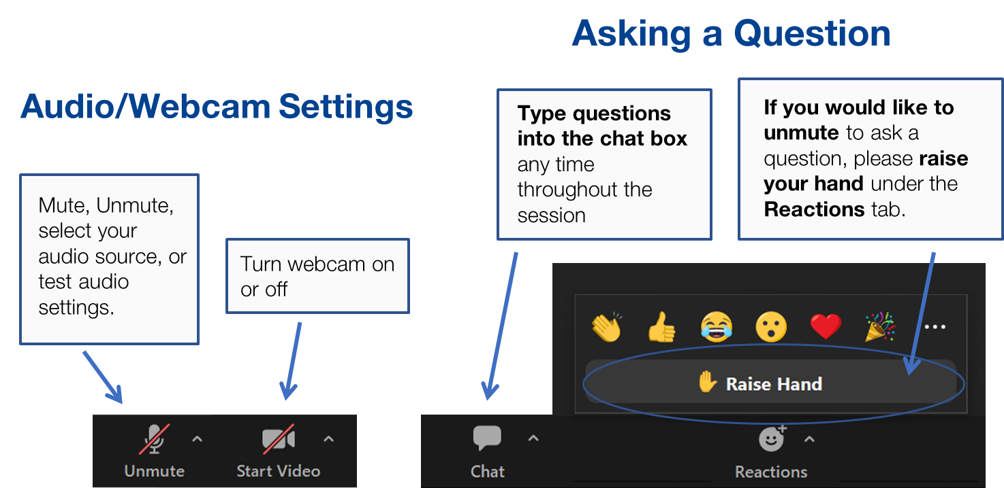
Zoom Logistics

Slide 3
Certificate of Completion
This session has NOT been submitted for pre-approval of Continuing Education Credits, but eligible attendees will receive a certificate of attendance for their personal record.
To receive a certificate:
You must attend the entire session
You must register and attend using your real name and unique email address - group viewing credit will not be acceptable
You must participate in all polling questions
Certificates will be sent via email within 30 days
If you have questions or need assistance, please contact smallsystems@syr.edu.

Slide 4

Who We Are
The Syracuse University Environmental Finance Center (SU-EFC) enhances the managerial and financial capacity of regional and local governments, nonprofit organizations, and local residents to improve environmental infrastructure, services, and quality of life.
Founded in 1993, SU-EFC operates at the intersection of science, policy, and communications, guided by a strong commitment to equity and environmental justice. We build capacity by providing technical assistance and tools to help local leaders make informed decisions that support community resiliency.​
Notes:
First, for a little bit about the Environmental Finance Center, our team enhances the managerial and financial capacity of regional and local governments, nonprofit organizations, and local residents, to improve environmental infrastructure, services, and quality of life. Our partnership with our co-hosts for this presentation is supported under a grant by the Rural Utilities Service, housed in the United States Department of Agriculture.

Slide 5
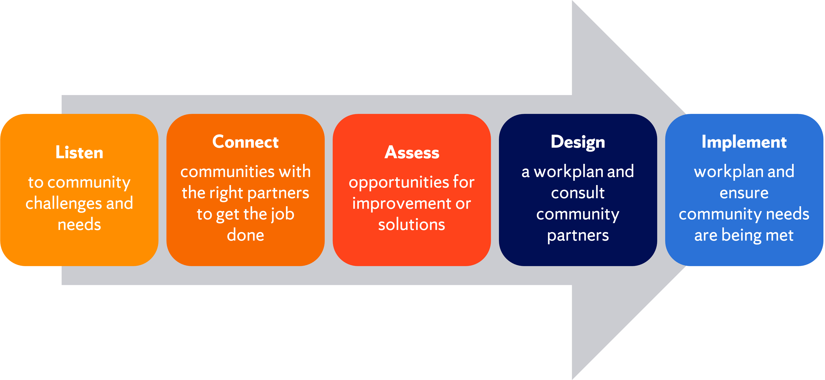
Our Approach
Notes:
We offer community assistance every step along the way or at individual junctions, our technical assistance can be scaled to fit the needs of any community.

Slide 6
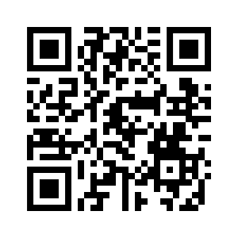
Tackle Your Water and Climate Challenges Head-On: Get Help From Our Team!
Assistance is free for communities in EPA Region 2 (NY, NJ, PR)
We use a flexible approach tailored to your community’s goals
Our team of providers have expertise across engineering, community engagement, funding & finance, and more!
Scan the QR code for more information or visit: efc.syr.edu/assistance

Slide 7
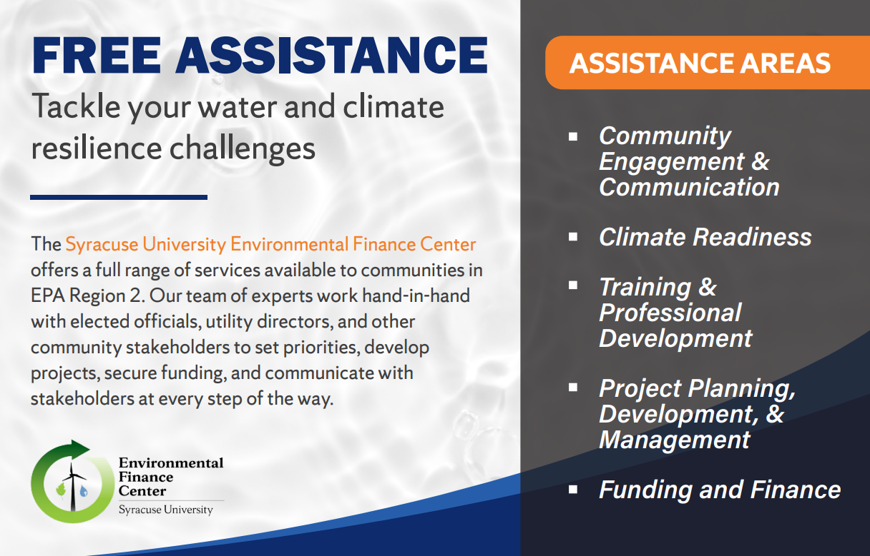
Examples of Technical Assistance:
Community Engagement
Messaging and Outreach
Needs Assessment, Planning Studies
Training and Professional Development
Project Planning and Development
Funding and Finance
Notes:
Please visit our website for additional information and feel free to stop by our table in the exhibit hall to pick up a postcard and speak to one of our representatives.

Slide 8

Today’s Training
Charlie Philion, Community Development, New York State Homes & Community Renewal
Nick Demitraszek, NYS Environmental Facilities Corporation
Candace Balmer, RCAP Solutions
Notes:
We have a fantastic lineup of speakers for you today from 6 agencies..

Slide 9
Who Are You?
Please raise your hand if you…
1.) Represent a community comprised of fewer than 2,500 residents
2.) Represent a community of between 2,500 to 5,000 residents
3.) Represent a community of larger than 5,000 or Other

Slide 10
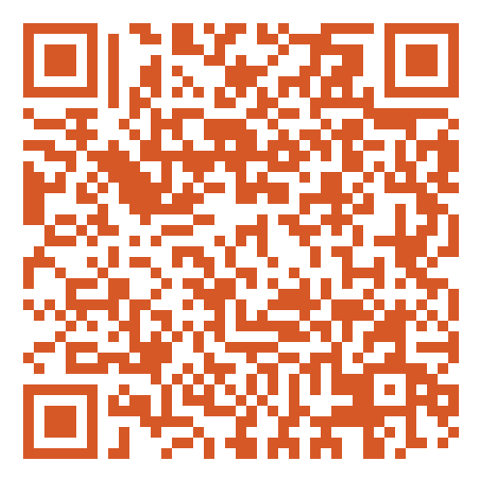
Please complete the evaluation
Jes Eckerlin
Syracuse University Environmental Finance Center (SU-EFC)
E: jeschn01@syr.edu
Notes:
That’s all we have today, thank you for joining us and please attend the Part 2 of this session at 2 PM in the Columbia Room on the 7th floor

