Slide 1
Smart Growth for Small Communities
Melissa Kramer
U.S. EPA Office of Sustainable Communities
October 6, 2010

Slide 2
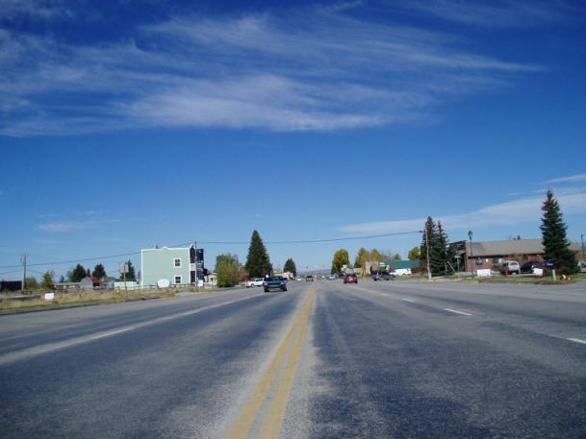
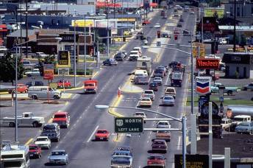
Conventional Development Patterns
“Affordable housing built miles from town – and transit
New intersections in the exurbs
Inefficient public spending on roads
Sewer lines built through agricultural lands
Bottom line: development that costs taxpayers a lot of money

Slide 3
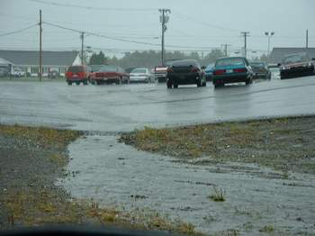
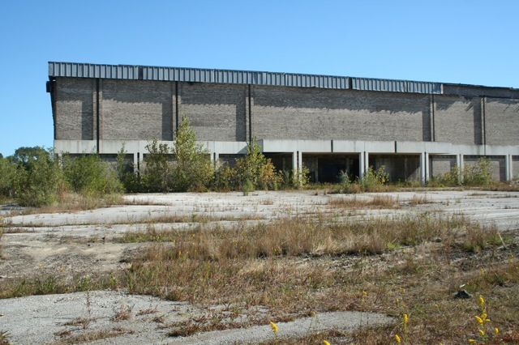
Environmental Impacts
Air quality
  Since 1990 CO2 emissions from personal vehicles rose by 23%; 80% from trucks
  Buildings and transportation account for about 2/3 of U.S. GHG emissions
Water quality
  EPA estimates>70% of urban water bodies impaired
Loss of habitat and critical areas
  Habitat loss is the main factor threatening 80% or more of endangered species

Slide 4
Smart Growth Principles
Mix land uses
Take advantage of compact building design
Create a range of housing opportunities and choices
Create walkable neighborhoods
Foster distinctive, attractive communities with a strong sense of place
Provide a variety of transportation choices
Preserve open space, farmland, natural beauty, and critical environmental areas
Strengthen and direct development towards existing communities
Make development decisions predictable, fair, and cost-effective
Encourage community and stakeholder collaboration in development decisions
Notes:
These principles have been adopted by 42 national organizations, 50 units of government, 40 NGOs, and 13 private sector groups

Slide 5
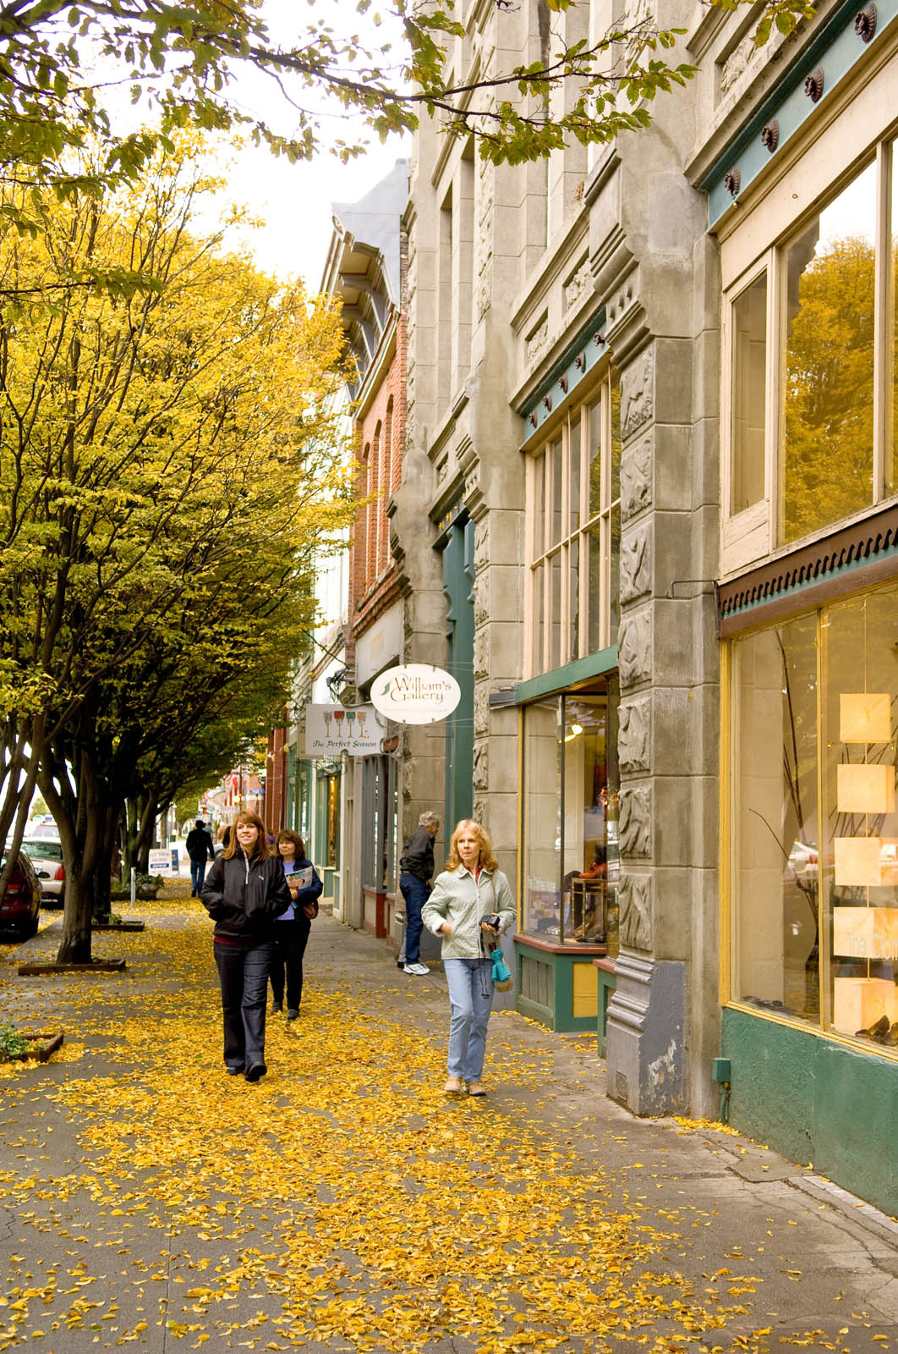
Environmental and Community Benefits of Smart Growth
Reduces water demand and utility service costs
Cleans up brownfields and returns them to productive use
  GAO estimates 425,000 brownfield sites nationwide
Creates more walkable, healthier neighborhoods
Reduces emissions
Protects natural and historic resources

Slide 6
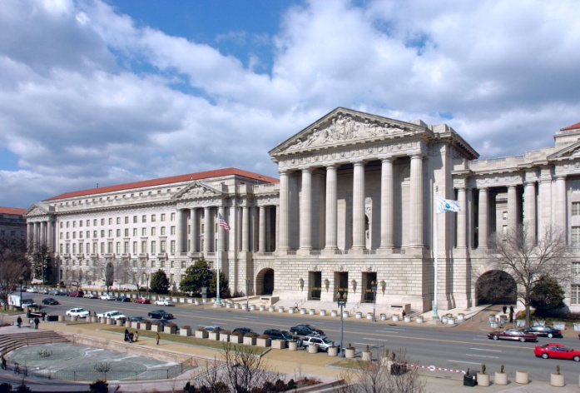
EPA’s Office of Sustainable Communities
Smart growth approaches help EPA achieve its mission to protect human health and the environment – where and how we build impacts our land, air, and water resources
What do we do
  Education and outreach
    – change the conversation
  Tools and technical assistance
    – help the willing
  Research and policy analysis
    – change the rules
Who do we work with
  Other EPA offices – Air, Water, Brownfields, Environmental Justice, Regions
  Other federal partners (DOT, HUD, FEMA, CDC, USDA, NOAA)
  All stakeholders in the growth and development process

Slide 7
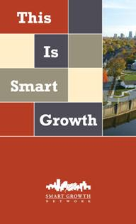
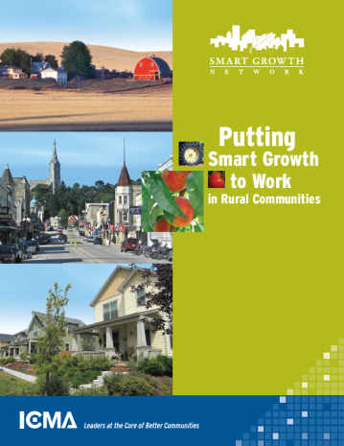
Changing the Conversation
Created and sustain the Smart Growth Network
  National coalition that defines and advances smart growth practices
  42 partner organizations
Created and sponsor the annual New Partners for Smart Growth Conference
  Over 1500 federal, state, and local government workers; developers; urban designers; and other stakeholders
Fund www. smartgrowth.org
National Award for Smart Growth Achievement
Notes:
ranging from the Urban Land Institute to the American Farmland Trust
Since 2002; 625 applications for 37 awards

Slide 8
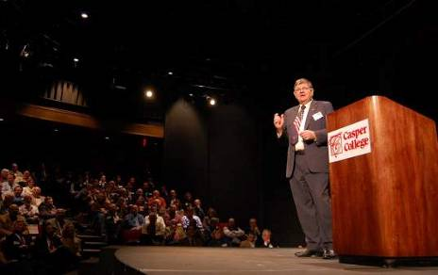
Helping the Willing
Technical assistance and other support to over 220 governors, state and local governments, and other stakeholders
Tools to address widespread problems
  For example, Essential Smart Growth Fixes for Urban and Suburban Zoning Codes
Governors’ Institute on Community Design
  Joint program with the National Endowment for the Arts – 10 governors since 2006
Wyoming Governor Dave Freudenthal discusses Wyoming’s future growth and development at the Building the Wyoming We Want conference sponsored by the Governors’ Institute on Community Design in Casper, January 2008

Slide 9
Changing the Rules
Federal
  Air: emission reductions from smart growth can now be used for required air quality plans
  Stormwater: state permit language recognizes the water quality benefits of specific smart growth land use strategies
National Standard Setters
  School siting: worked with partner organizations to remove “minimum acreage” requirements from national guidelines
  Institute for Transportation Engineers: developed new guidelines supporting streets and roads that better support biking, walking, and transit

Slide 10
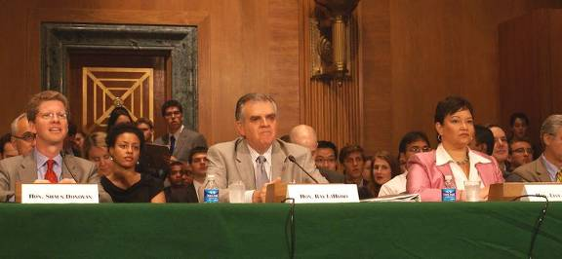
Partnership for Sustainable Communities: EPA, HUD, and DOT
Mission: to meet the President’s challenge for our agencies to work together to encourage and fully assist rural, suburban, and urban areas to build sustainable communities, and to make sustainable communities the leading style of development in the United States
Focused on ensuring that federal investments, policies, and actions do not subsidize inefficient development and, instead, support sustainable communities and effective investments
Notes:
March 2009: HUD and DOT form Partnership
Recognition that transportation costs must be included into the calculations of housing costs.
June 2009: EPA joins Partnership
Recognition that our water, brownfield, and air investments, policies, and actions can be part of the solution
There is now a real understanding– at the highest level– that money from the federal government can and does influence the type and location of development. And that we need to be mindful about how these flows of money can support development that is in line with the goals of this partnership.

Slide 11

Partnership for Sustainable Communities: Accomplishments
Provide and coordinate funding
  Joint HUD/DOT notice of funding availability in June
  HUD $100 million Sustainable Communities Regional Planning grant program
  LEED-ND system adopted to evaluate proposals for HUD’s $3.25 billion discretionary funding grant programs
  EPA guidance to states for federal water and wastewater infrastructure funds, ~$3.3 billion
Remove regulatory barriers at the federal level
  Executive Order to improve the sustainability of federal government facilities
  New DOT bicycle/pedestrian policy
  Joint reviews for EPA’s Brownfields Area-Wide Planning Pilot Initiative
Align agency priorities and institutionalize the principles of the partnership
  Joint evaluations of grant applications
  Joint development of Notices of Funding Availability
Notes:
The joint grant program offers up to $75 million in funding – $35 million in TIGER II Planning Grants and $40 million in Sustainable Community Challenge Grants – for local planning activities that integrate transportation, housing, and economic development
which will be awarded competitively to support regional planning efforts that integrate housing, land use, economic and workforce development, transportation, and infrastructure investments in a manner that empowers jurisdictions to consider the interdependent challenges of economic growth, social inclusion, and environmental impact. In addition, applicants that meet a specified threshold score can also qualify for Preferred Sustainability Status that will give them access to a broad spectrum of benefits, including capacity building resources and secure potential points in a number of funding opportunities managed by other federal agencies, including DOT and EPA.
The EO, signed last October, includes requirements for setting greenhouse gas reduction targets, encouraging community planning, and creating high-performance buildings.
that balances the needs of non-motorists in federally funded road projects, discourages transportation investments that negatively affect cyclists and pedestrians, and encourages investments that go beyond the minimum requirements to provide facilities for bicyclists and pedestrians of all ages and abilities. Additionally, the Federal Transit Administration published a proposed policy statement that would extend eligibility of federal transit funds for pedestrian and bicycle improvements.

Slide 12
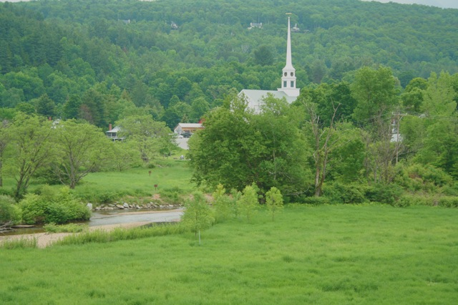
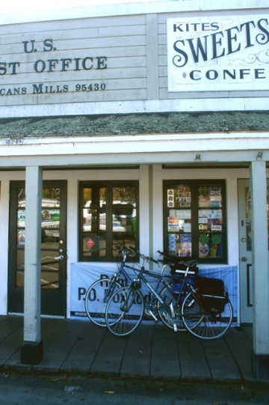
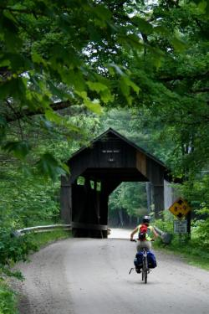
What Does Smart Growth Mean for Small Communities?
Economy, culture, transportation have changed
Some communities growing rapidly; others are declining
Fewer farms and farmers
Loss of forest and other natural and productive lands
Limited planning capacity
Need economic diversity and an expanded set of options for where to live, where to work, and how to get around

Slide 13
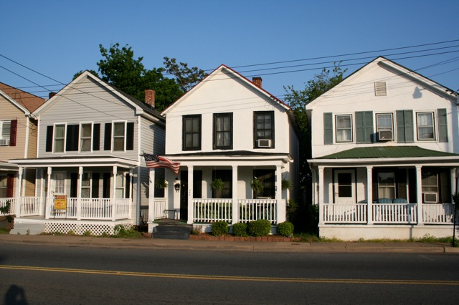
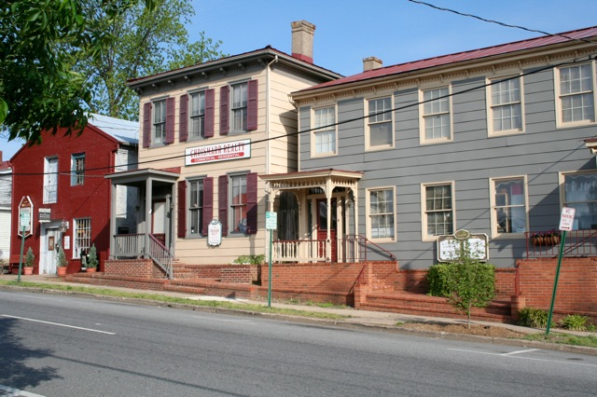
Working in Small Communities
Provide technical assistance in many small communities (~20% of applications)
Governor’s Institute workshops include rural focus – Montana, Wyoming, Arizona, New Mexico, Iowa, North Carolina
Resource development
  Putting Smart Growth to Work in Rural Communities
  Essential Smart Growth Fixes for Rural Planning, Development, and Zoning Codes
Rural development category in 2010 Smart Growth Achievement Awards
Partnership for Sustainable Communities established a Rural Workgroup with USDA participation

Slide 14

Putting Smart Growth to Work in Rural Communities
Partnership between U.S. EPA and ICMA – A Smart Growth Network Publication
Lays out a framework for rural communities and small towns seeking to implement smart growth
Set of tools, case studies, and resources

Slide 15
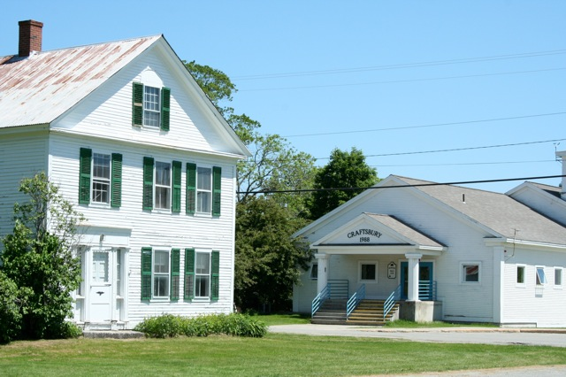
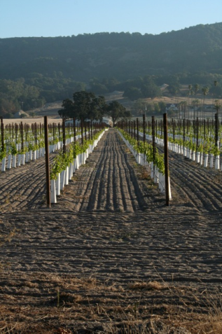
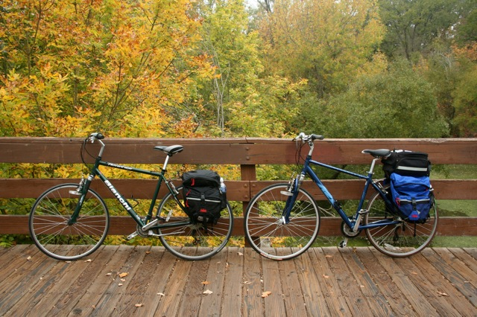
Three Broad Goals
Support the rural landscape
Help existing places thrive
Create great new places

Slide 16
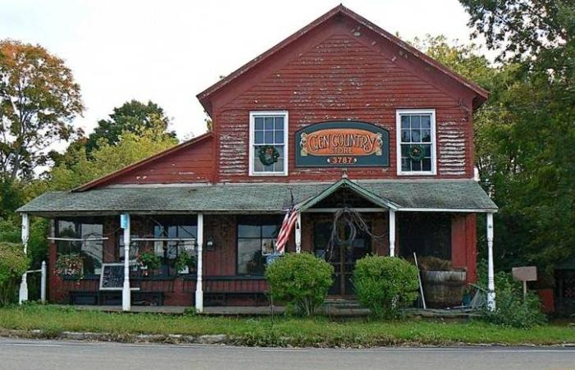

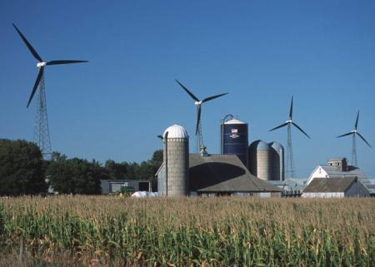
1. Support the Rural Landscape
Create and economic climate that enhances the viability of working lands and conserves natural lands is the first step
Strategies, tools, and policies that support this goal include:
  Right to farm policies
  Agricultural zoning
  Renewable energy development
Photo Credits (top to bottom, left to right): National Trust for Historic Preservation , EPA, NRCS

Slide 17
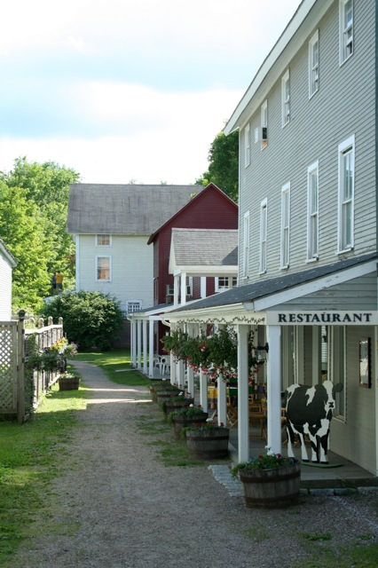
2. Help Existing Places Thrive
Take care of assets and investments such as downtowns, Main streets, existing infrastructure, and places that the community values
Strategies, tools, and policies that support this goal include
  Fix-it-first policies
  Rehabilitating existing structures, e.g., schools
  Incentives to encourage infill and brownfield redevelopment
  Updated zoning ordinances and development codes that support compact, walkable development

Slide 18
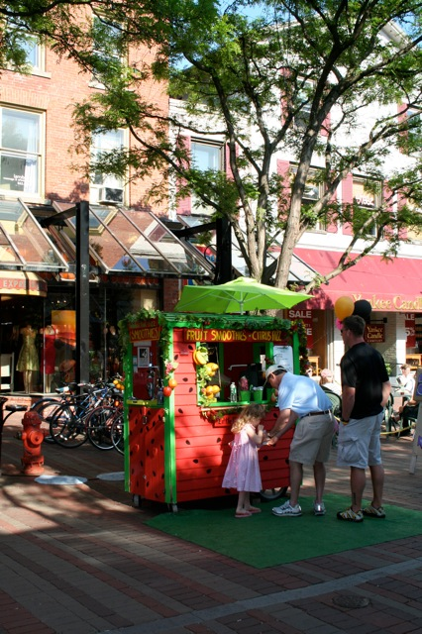
3. Create Great New Places
Build vibrant, enduring neighborhoods and communities that people, especially young people, don’t want to leave
Strategies, tools, and policies that support this goal include
  Community visioning and planning alignment
  Designating growth areas and areas for preservation
  Recognizing developers that build great places

Slide 19
Further information
www.epa.gov/smartgrowth
Melissa Kramer
  kramer.melissa@epa.gov
  202.564-8497

