Slide 1
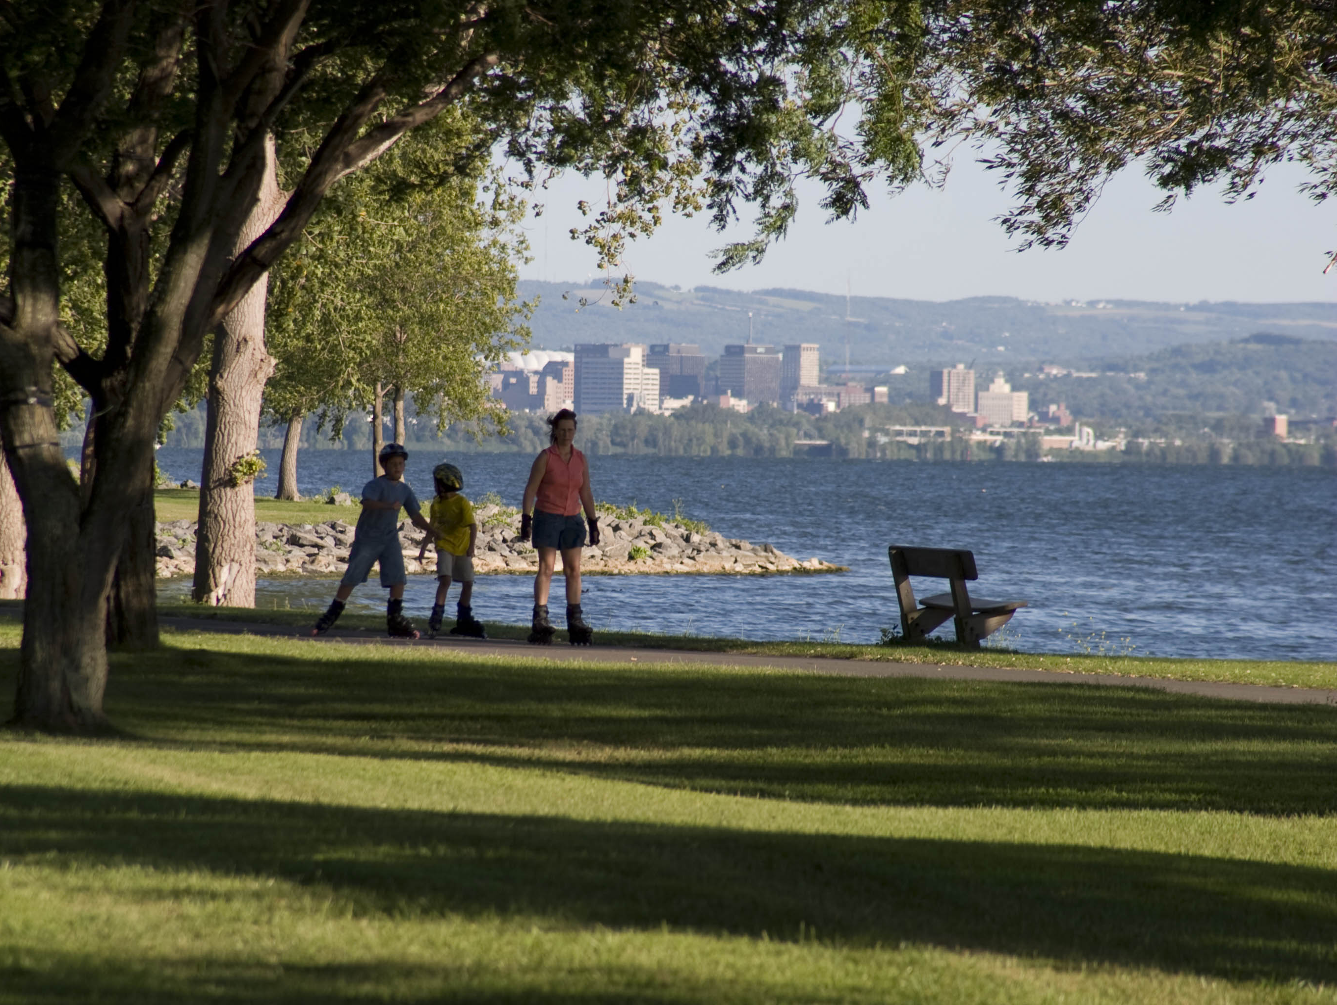
New York State
Environmental Facilities Corporation
Minnowbrook Local Leaders Conference
April 25, 2013
Governor Andrew M. Cuomo President Matthew J. Driscoll

Slide 2
The Environmental Facilities Corporation
Providing Low-cost Financing and Technical Assistance to Municipalities, Businesses, and NY State Agencies for Environmental Projects
Clean Water State Revolving Fund (1987 Clean Water Act Amendments)
Provides financial assistance for wastewater and water quality infrastructure
Drinking Water State Revolving Fund (1996 Safe Drinking Water Act)
Provides financial assistance for drinking water infrastructure

Slide 3
New York’s Water Infrastructure
Backbone of our Communities
Retains Business and Industry
Foundation of Economic Development
Protects Water Resources
Provides a Better Place to Live and Play

Slide 4
Brief Background on the SRF’s

Slide 5
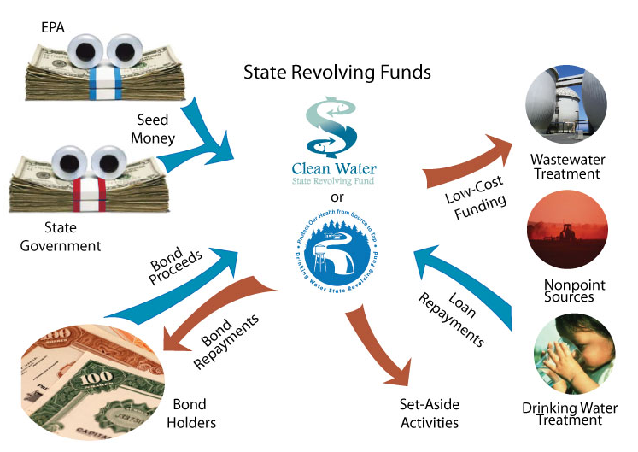
How SRF Programs Work

Slide 6
Clean Water State Revolving Fund
A variety of publicly-owned water quality improvement projects are eligible for low-interest financing including:
Point Source Projects (wastewater treatment facilities)
Nonpoint Source Projects (stormwater management projects and landfill closures)
Certain habitat restoration/protection projects in national estuary program areas

Slide 7
Drinking Water State Revolving Fund
Provides subsidized low-interest rate financing and limited grants for public and private drinking water infrastructure including:
Treatment plants
Distribution mains
Storage facilities

Slide 8
Clean and Drinking Water SRFs
Clean Water | Drinking Water
Leveraged rate financing with 50% subsidy for up to 30 years (1.57% November 2012) | Leveraged rate financing with 33% subsidy for up to 20 years and years 21-30 at AAA rates (2.09% November 2012)
Hardship financing as low as 0% interest for up to 30 years | Grants up to $2 million for hardship projects + financing as low as 0% interest for up to 30 years
Subsidy financing determined on priority scoring system, impacts of water quality and public health
Short-term financing for 3 years at 0% interest
Short and Long-Term Market Rate Programs (AAA tax-exempt rate) (Long-Term Market Rate- 3.14%)

Slide 9
SRF Intended Use Plan (IUP)
Published on an annual basis, describes program, identifies funds available, and the use of those funds.
Effective October 1st through September 30th (Federal Fiscal Year)
Project Priority Lists of potentially eligible projects
Annual List (Projects expecting financing in current year)
Multi-Year List (Projects to be financed in future years)
Excerpt from 20XX Final CWSRF IUP - Project Category: B
Project # | Applicant Name | Service Area | Project Description | Est. Amount | Additional Above ST | SPDES no | Score
C1-XXX-XX-00 | GREAT NECK, VILLAGE OF | VILLAGE | STP UP | $17,200,000 | $17,200,000 | NY0022128 | 154
C1-XXX-XX-00 | NASSAU COUNTY | BAY PARK, SD #2 | NPS, STMSEW | $430,000 | $430,000 | NY0026450 | 113
C6-XXX-XX-00 | UTICA, CITY OF | PHASE A1 | CSO, I/I CORR | $2,850,000 | $2,850,000 | NY0025780 | 112
C9-XXX-XX-00 | TONAWANDA, TOWN OF | PARKERS-FRIES INTERCEPTOR | COLL, INT | $24,310,000 | $24,310,000 | NY0026395 | 111
C6-XXX-XX-00 | ONEIDA COUNTY | PHASE 1 | CSO, I/I CORR | $5,300,000 | $5,300,000 | NY0025780 | 107
C6-XXX-XX-01 | ONEIDA COUNTY | PHASE 2A | CSO, I/I CORR | $20,500,000 | $20,500,000 | NY0025780 | 107
“Subsidy Line”

Slide 10
CWSRF IUP Categories
Category | Description
A | Populations up to 3,500
B | Populations 3,501 – 2 million
C | Populations over 2 million (New York City)
D | Hardship Communities
E | Non-Municipal, Non-Point Source
G | GIGP

Slide 11
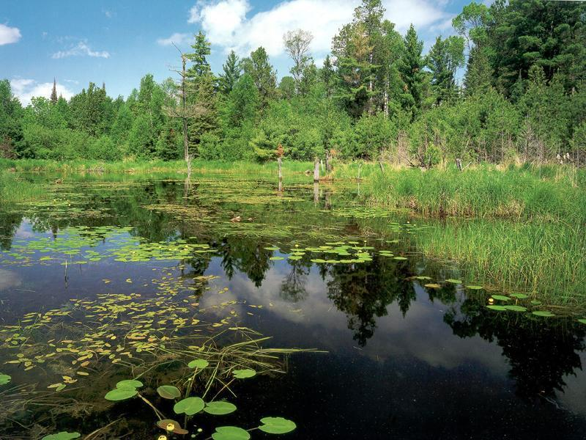
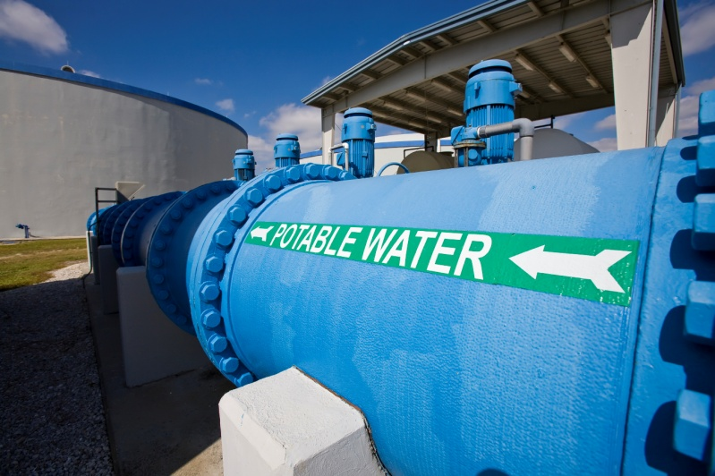
FFY 2013 State Revolving Fund Program Updates and Best Practices

Slide 12
CWSRF Finance Application Process FFY 2013
Beginning October 1, 2012, all financing applications are required to include:
Complete and signed application form
SEQR (completed) and SHPO (signed off)
Sewer District Formation (where applicable)
Bond Resolution adopted
Applications not complete by February 1, 2013 are considered bypassed.

Slide 13
Project Funding Process
1. EFC/DOH receives Listing Form and Engineering Report from the Applicant. The project is then scored and added to the IUP.
3. Applicant creates sewer or water district, if applicable.
2. Applicant initiates required environmental reviews- SEQR/SHPO, DEC issues SERP and regional certs.

Slide 14
Project Funding Process
4. Applicant executes a bond resolution authorizing debt
6. Applicant submits an application. EFC and Applicant collaborate to develop and properly size the financing. The closing will be scheduled when sufficient documentation has been submitted.
5. DOH/DEC and/or EFC approve the engineering report.

Slide 15
Project Funding Process
7. EFC closes short-term financing.
9. EFC closes long-term financing and tracks project until it is complete.
8. EFC continues to develop the financing. This includes:
-updating the budget to reflect current budget costs
-coordinating the submission and review of contracts
-processing disbursement requests

Slide 16
Most Common Items Needed to Complete Your Application
Detailed project budget and schedule
Identification of proper financing
Certified copy of the authorizing bond resolution
MWBE information
Permits/Approvals as needed
Key contact information
Contracts/agreements and related amendments
Invoices supporting costs incurred to date
Inter-municipal agreements
Debt information
Documents detailing existing debt and/or third party funding sources
Financial information necessary to complete a Credit Assessment

Slide 17
MWBE/EEO Program Changes FFY 2013
The participation goal is 20% combined MBE/WBE as of 10/1/2012
The goal applies to:
Construction contracts greater than $100,000
Non-construction contracts greater than $25,000
Change orders and amendments greater than $25,000
The bid packet is a resource for guidance, goals, and good faith effort information
SRF recipients are required to designate an MBO
Enhancing forms
New Excel Quarter Report Forms
Visit MWBE website for more information www.efc.ny.gov/MWBE

Slide 18
CWSRF Hardship Eligibility
Limited to sewage treatment projects primarily serving ≥ 50% residential areas
Changes
 | FFY 2012 | FFY 2013
Project cost for reduced interest rate financing | $14 Million | $18 M / $25 M
Census/MHI Year Data | 2000 data | 2010 data
Maximum MHI to qualify for Hardship | $65,090 | $83,405
Notes:
State the following: Same goes to DOH!

Slide 19
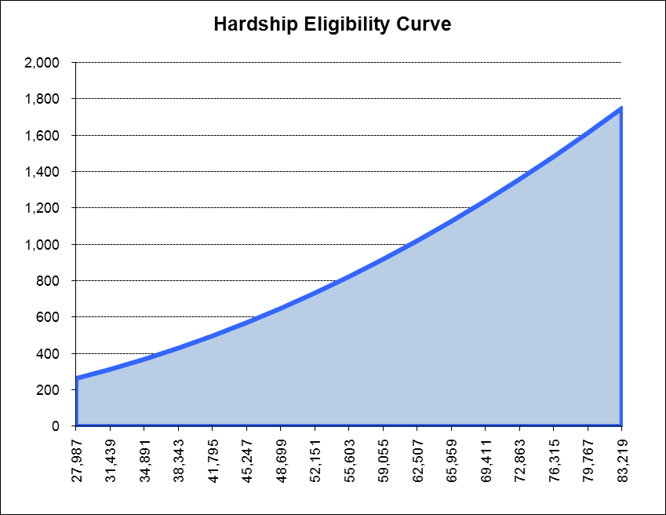
CW: 2010 Hardship Eligibility Curve
$ Per Equivalent Dwelling Unit
Qualifies for Hardship
Target Service Charge
Does not qualify for Hardship
Median Household Income

Slide 20
Davis-Bacon (D-B)
Applicability
Permanent requirement for CWSRF and DWSRF
Applies to Federal, State or recycled funded projects
Applies to the entire project, even if the project is only partially funded by the SRF
Applies to construction contracts over $2,000 and all subcontracts on prime contracts over $2,000, regardless of the subcontract amount
Notes:
The $1.00 Rule: even if a project only receives $1.00 of srf funding, and is otherwise fully funded by other sources, davis-bacon requirements apply to the entire project

Slide 21
Energy Efficiency FFY 2013
Engineering reports are required to incorporate NYSERDA Baseline Standard Practices
Energy evaluations may be performed by NYSERDA to identify energy efficiency opportunities for many CWSRF projects
There may be no cost to the community for NSYERDA energy evaluations
Interested communities are encouraged to contact EFC

Slide 22
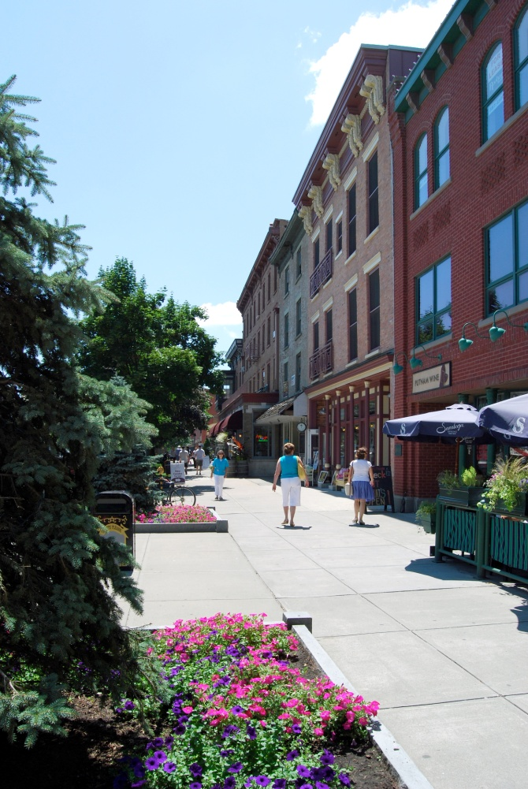
Smart Growth Public Infrastructure Policy Act FFY 2013
All projects to be financed must be evaluated for compliance
Smart Growth Assessment required with all engineering reports submitted after October 2012
SG guidance available on EFC’s website

Slide 23
PLUS
2013 Project Updates- Will be required for all active projects in April 2013
If April 2013 updates are not received prior to the deadline for comments on the draft IUP, the project will not be eligible for financing in FFY 2014

Slide 24
Deadlines for FFY 2013 CWSRF IUP & Financing
February 1, 2013 Applications Due for Subsidized Financing for projects in Cat. D and above the subsidy lines in Cat. A and B
March 2013 PLUS Updates for 2014 IUP
May 1, 2013 Deadline: Submit Hardship Applications for inclusion in Category D of the 2014 IUP (project must be on the IUP)
June 2013 Draft 2014 IUP Issued
July 2013 Public Hearing on Draft 2014 IUP
August 1, 2013 Deadline: Submit project listing information for Final 2014 IUP
September 30, 2013 End of FFY 2013 IUP financing period
October 1, 2013 Beginning of FFY 2014 IUP financing period

Slide 25
Deadlines for FFY 2013 DWSRF IUP & Financing
March 1, 2013 Applications due for Subsidized Financing
May 13, 2013 Applications due for Market-rate Financing
September 30, 2013 End of FFY 2013 IUP financing period
December 1, 2013 Hardship Applications due

Slide 26
Annual List Requirements FFY 2014
To be included on the Annual Year Project Priority List:
Approvable Engineering/Technical Report or “Land Acquisition Plan” & Targeted Parcels List for Land Acquisition
Executed contract for engineering planning services (if planned to finance cost with project) for listings after October 1, 2012
Smart growth assessment

Slide 27
Current EFC Initiatives

Slide 28
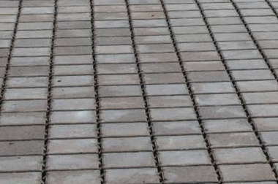
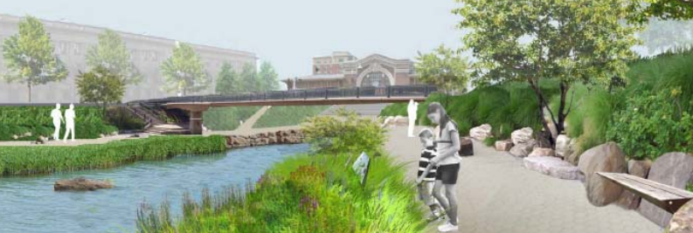
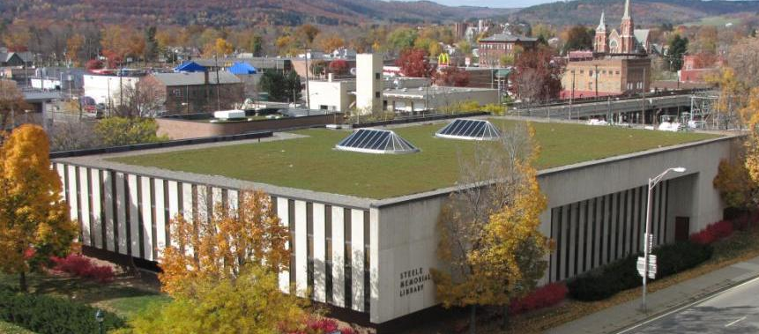
Green Innovation Grant Program (GIGP)
Projects that qualifies under EPA’s definition of Green Project Reserve
Highly competitive, award-winning grant program
Available through CFA
After 4 rounds, ~$92M allocated to 121 green projects across the state, including 17 projects announced in December 2012
No cap - up to 90% funding for eligible costs

Slide 29
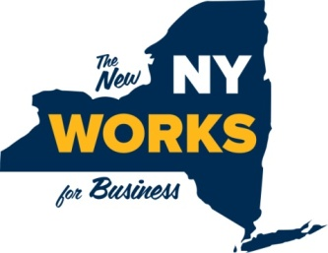
CWSRF Engineering Planning Grants
Planning of CWSRF-eligible projects
Engineering Reports
Environmental Review
Application through Consolidated Funding Application (CFA)
Administered with NYS Department of Environmental Conservation (DEC)
2012- A total of $1 million awarded to 37 local entities
Grants up to $30,000; 20% local match, can be in-kind services
Communities less than 30,000 population
MHI equal or less than $55,000 (2010 US Census)
2013- $2 million available

Slide 30
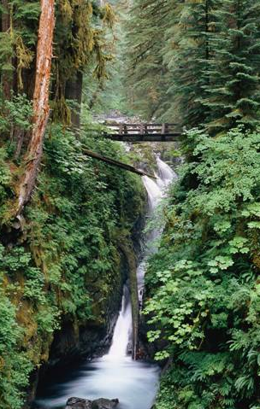
EFC Client Services
Application Assistance
Legal, Engineering, Financial Expertise
Individual Project Consultations
On-site Visits
Field Offices
Public Outreach and Education
Co-Funding
Post Closing Assistance

Slide 31
How EFC Fits Into the Future
Growing jobs
Helping build a base to support economic development
Supporting business
Equals strong infrastructure and reliability
Promoting economic development
Identify industries with site-specific needs
Supports Water Infrastructure Industry
Creating innovative partnerships
Generating private investment
Every $1 invested = $6.35 return

Slide 32
The New York State
Environmental Facilities Corporation
Jason Denno
Environmental Project Manager
Jason.Denno@efc.ny.gov
518.623.1244
Financing for a Sustainable Future
www.efc.ny.gov
Notes:
32

