Slide 1
Area Planning to Facilitate Economic Development: A Guide for Upstate, NY
Presented by the Town of Dryden, NY:
Dan Kwasnowski, AICP, Director of Planning
Jane Nicholson-Dourdas, AICP, Senior Planner

Slide 2
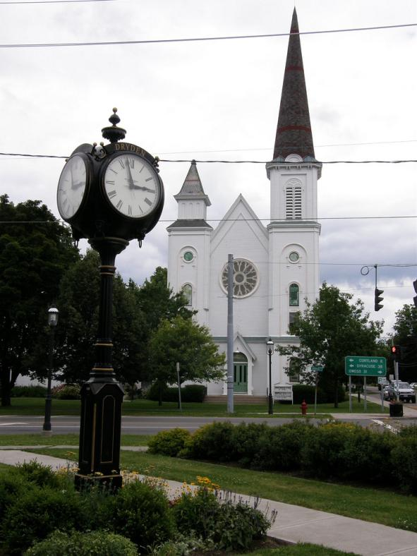
Development in your Community
How much does new development cost?
How is your tax base being used?
Does your tax base add to the overall quality of life in your community?
What is the character?

Slide 3
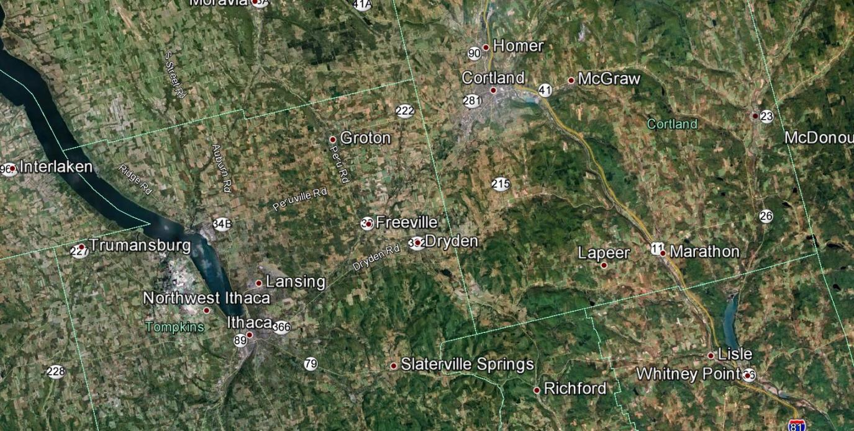
The Town of Dryden, New York

Slide 4
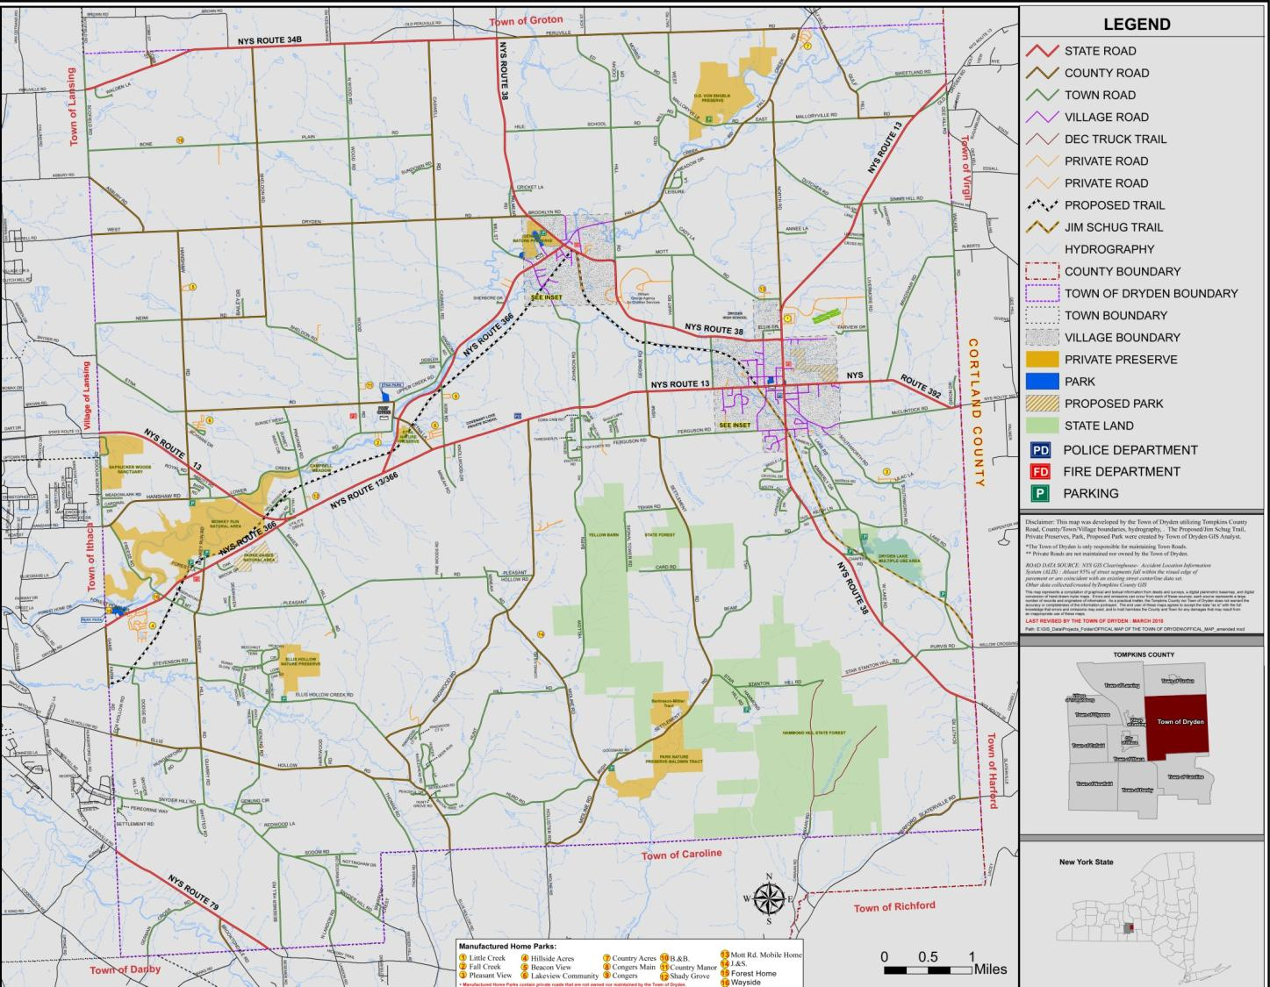
The Town of Dryden, New York

Slide 5
Comprehensive Plan
Population
Land Use
Open Space & Environmental Resources
Historic Resources
Recreational Resources
Transportation
Public & Semi-Public Infrastructure
Public Safety
Jim Schug Trail, Dryden, New York

Slide 6
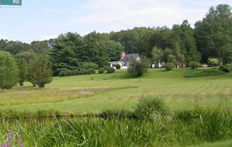
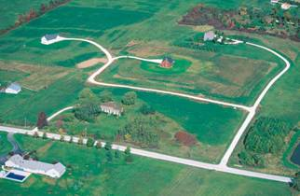
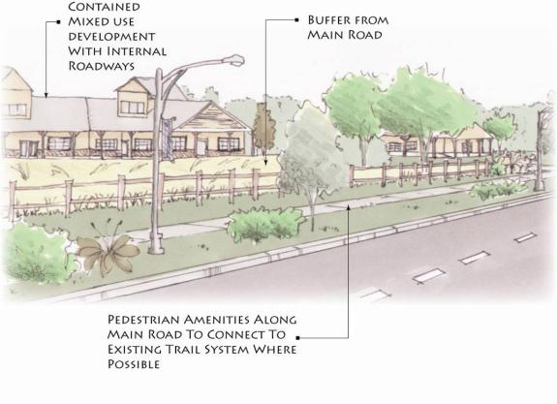
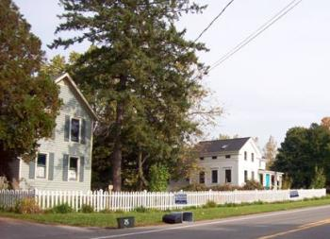
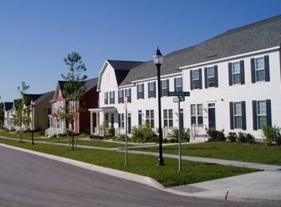
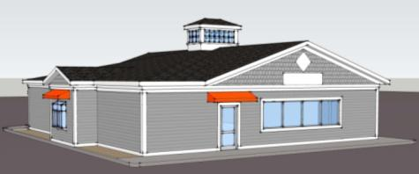
Design Guidelines
Residential
Commercial
desirable
undesirable
minimum setbacks
multifamily housing
example: Xtramart

Slide 7
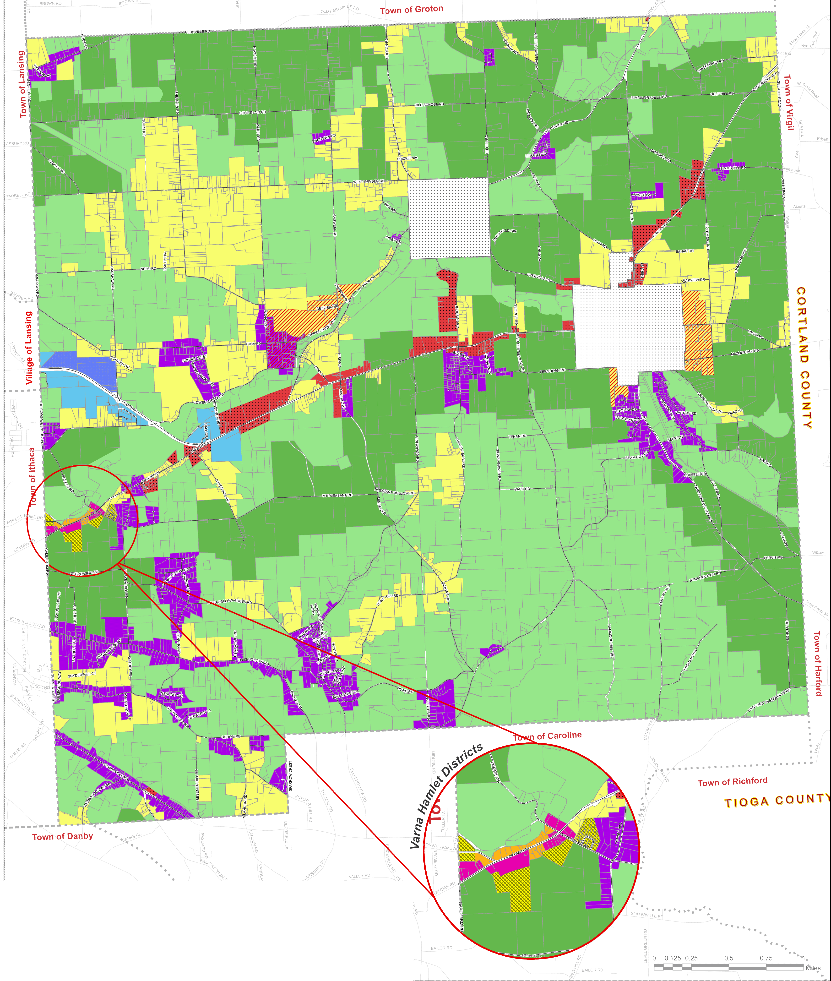
Zoning

Slide 8
Area Planning

Slide 9
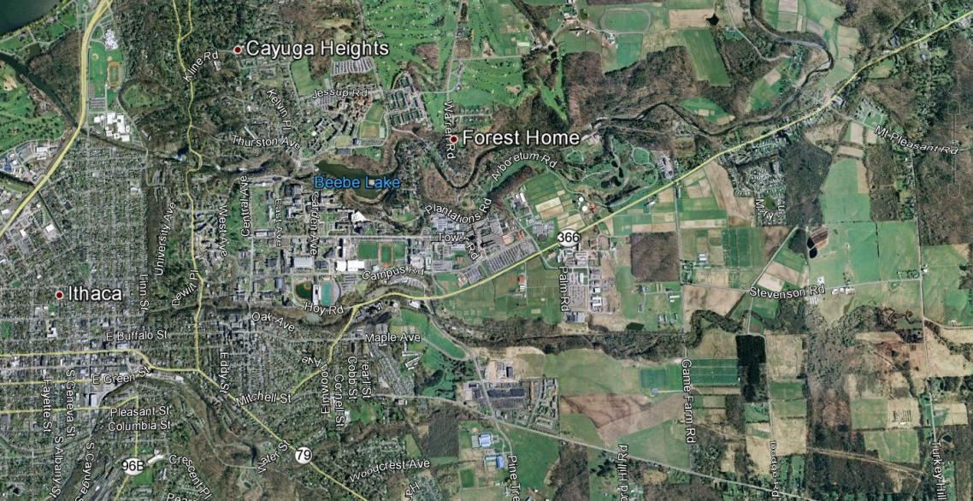
Varna Community Development Plan
3 Reasons to Plan:
1. Access to Municipal Water and Sewer
2. Development Pressure
3. Existing Infrastructure

Slide 10
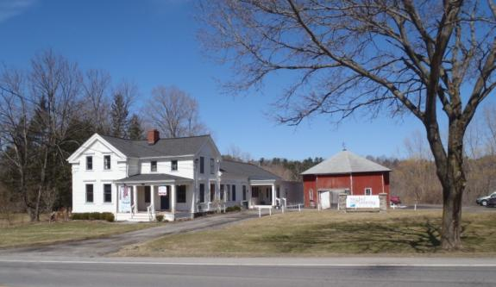
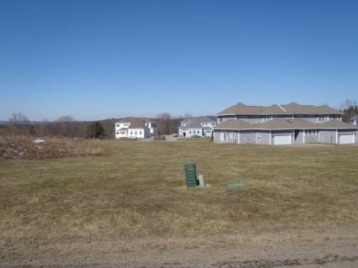
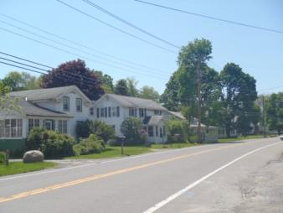
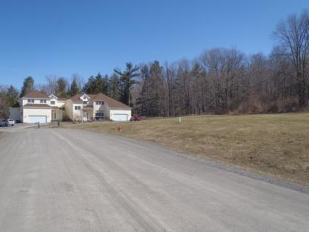
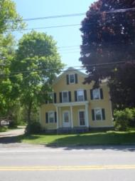
Character Planning
Retain hamlet character
hamlet character
conventional development

Slide 11
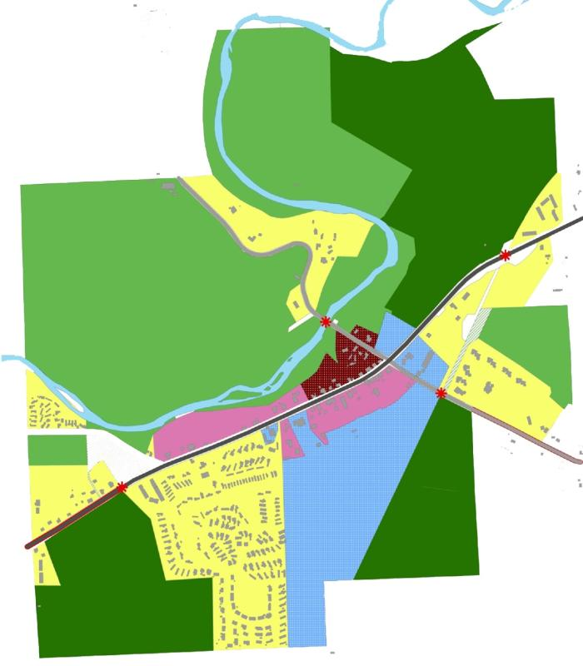
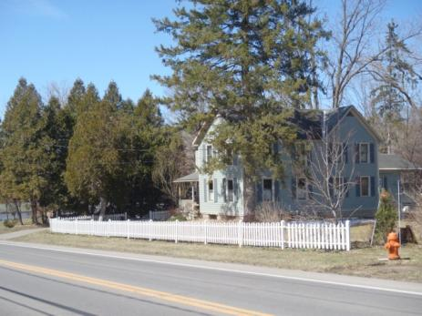
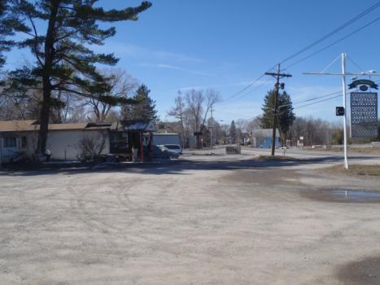
Character Planning
Character Area Assessment
traditional
redevelopment

Slide 12
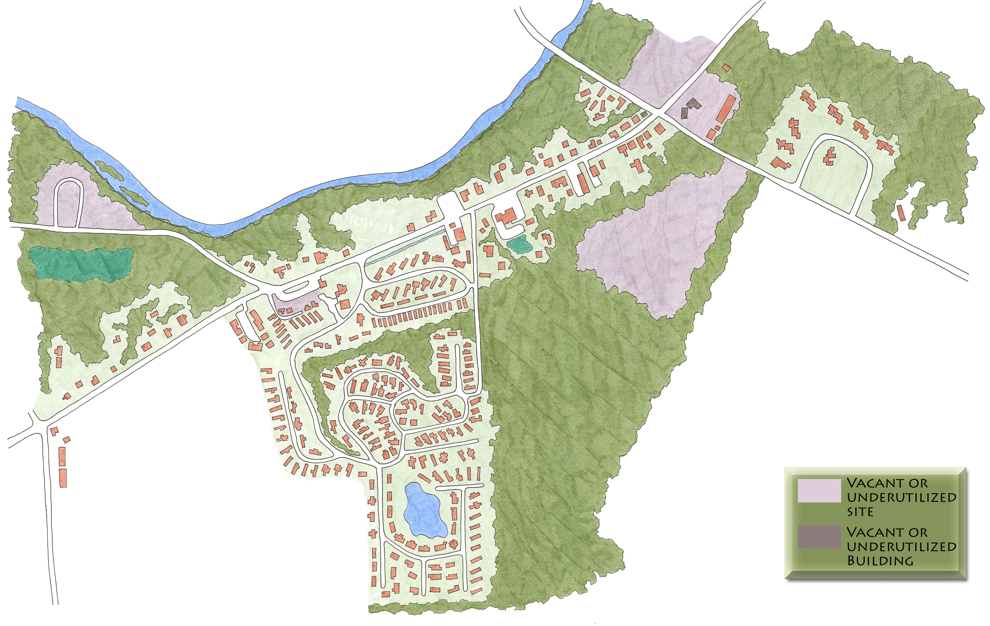
Character Planning
Existing Conditions Analysis

Slide 13
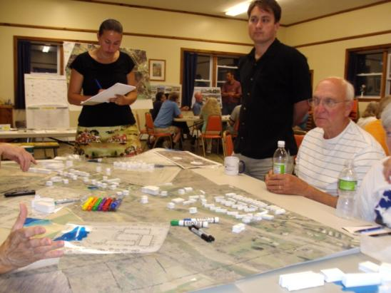
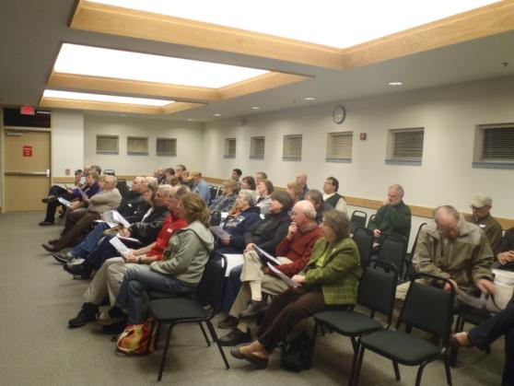
Public Outreach and Participation
Varna Advisory Committee
Meetings with Business Owners
Community Survey
Public Workshop
Open House

Slide 14
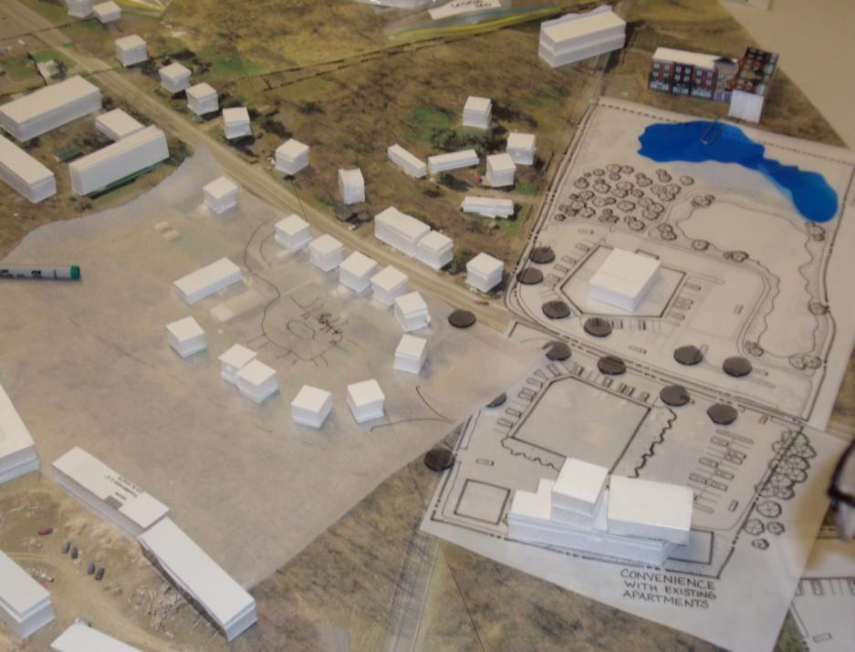
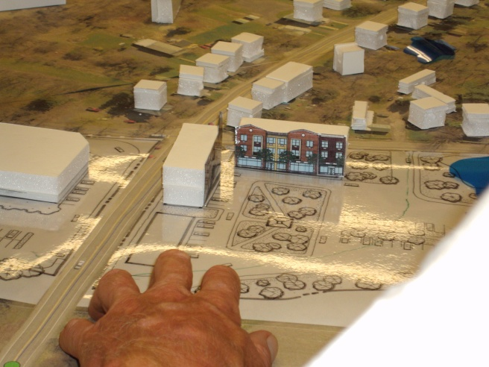
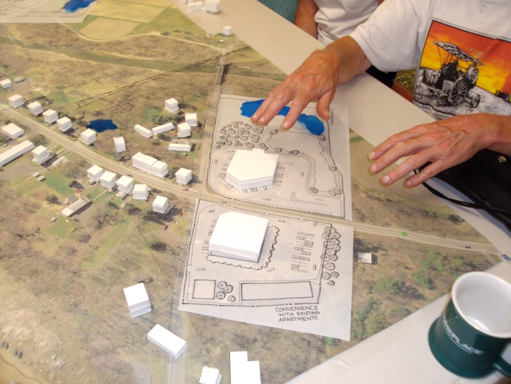
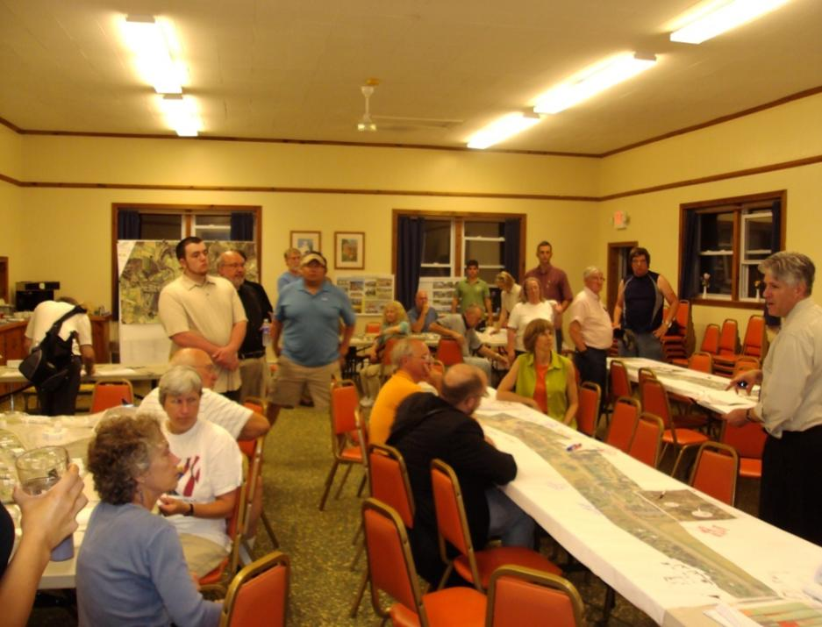
Public Workshop ~ June 21, 2011

Slide 15
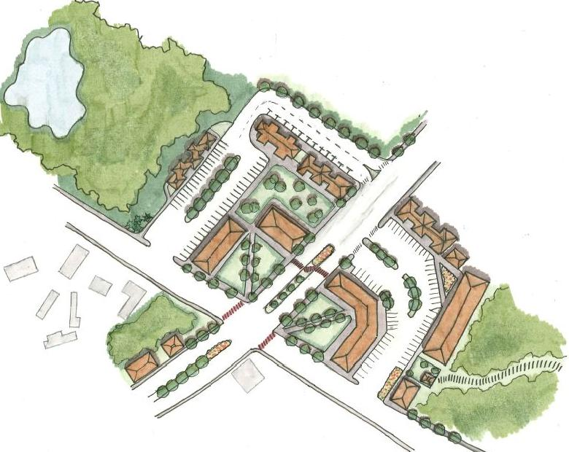
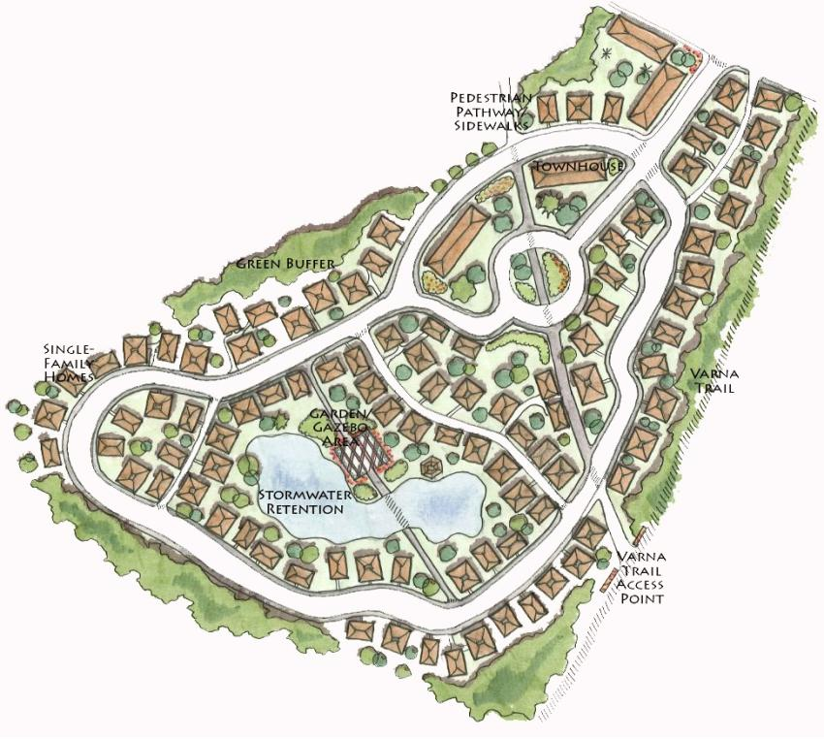
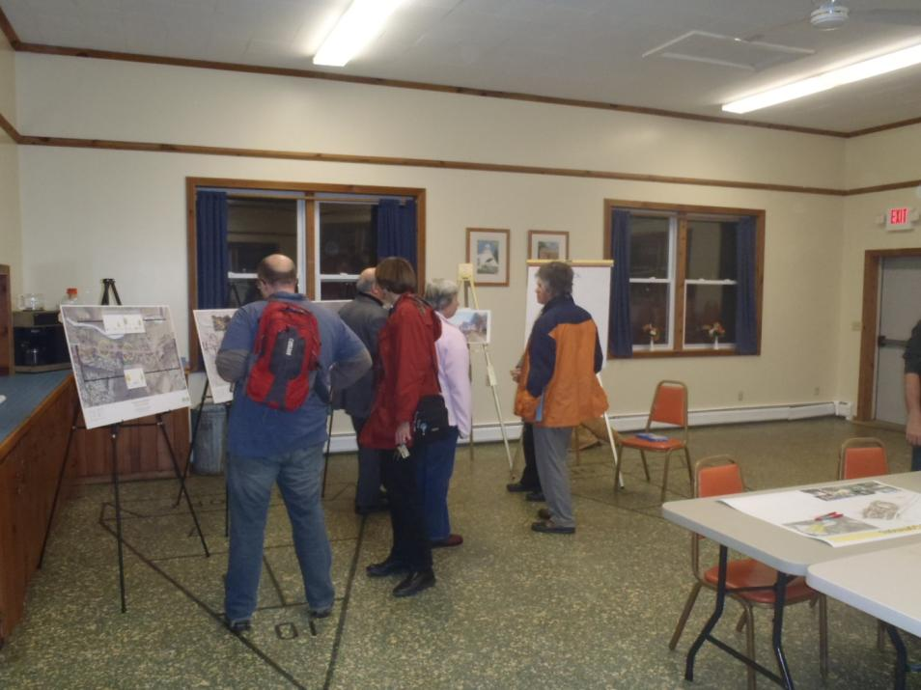
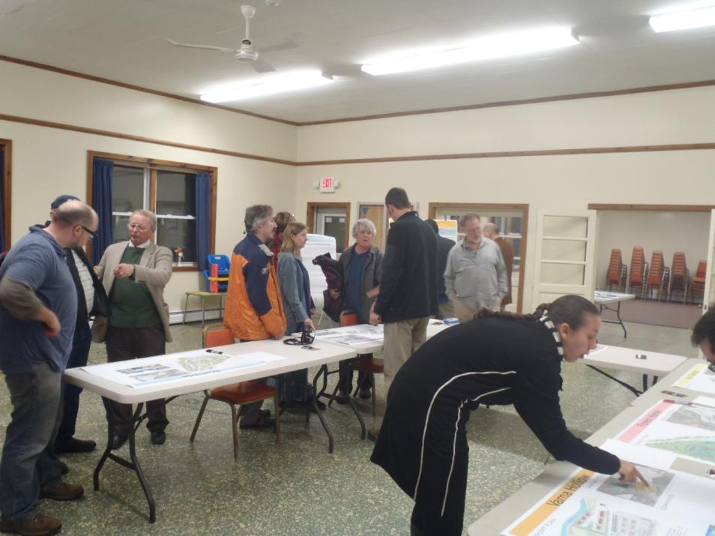
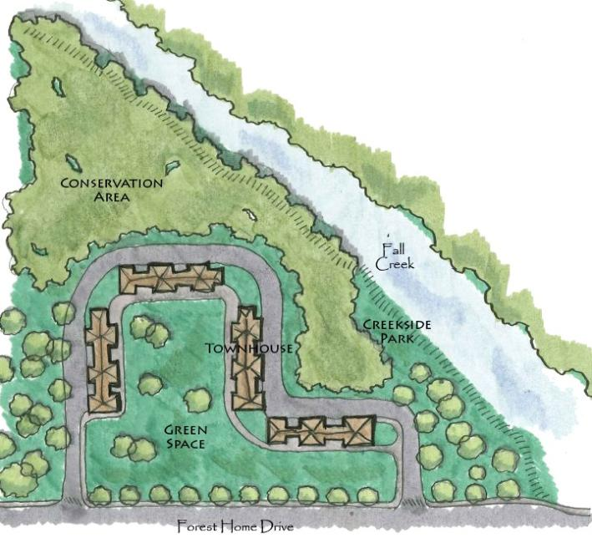
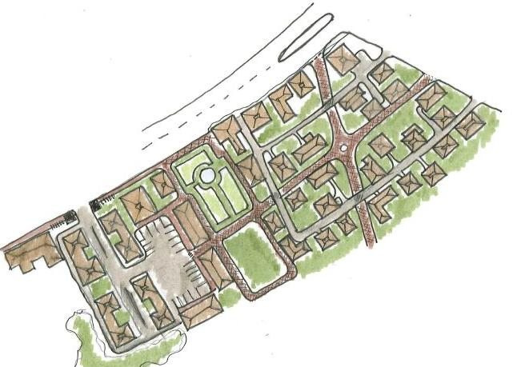
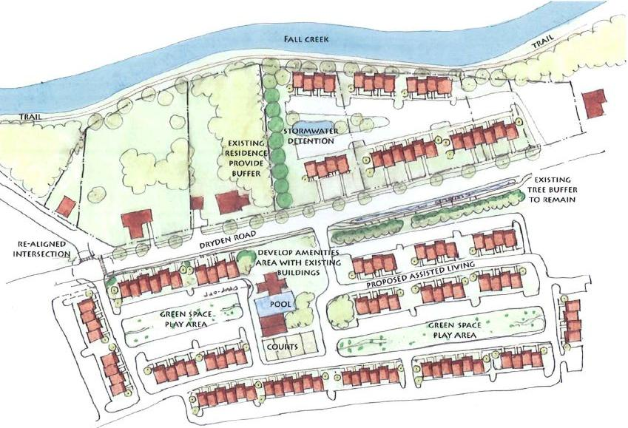
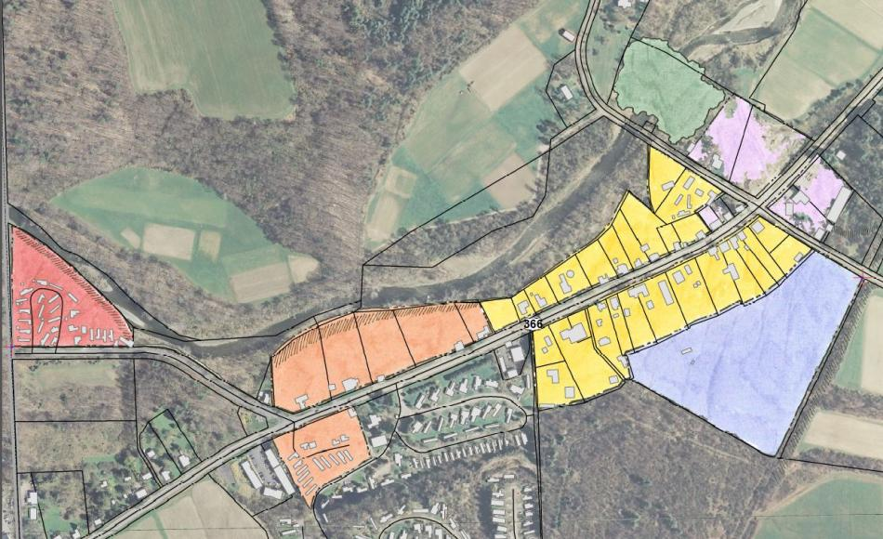
Open House ~November 2, 2011

Slide 16
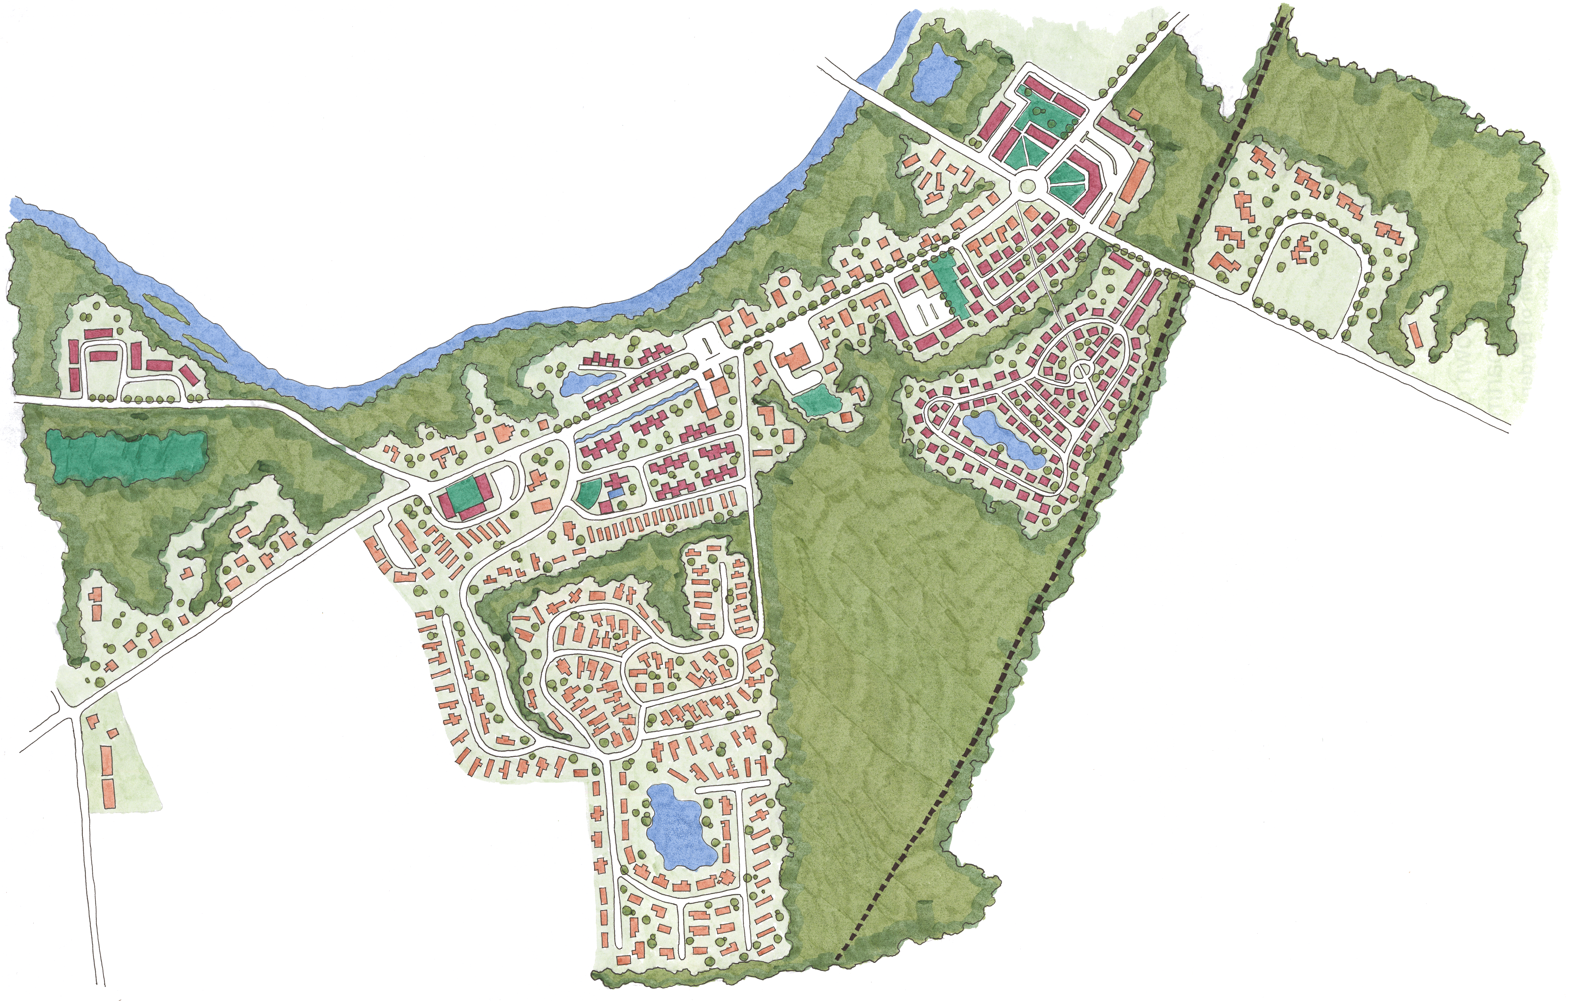
Small Area Master Plan and Zoning

Slide 17
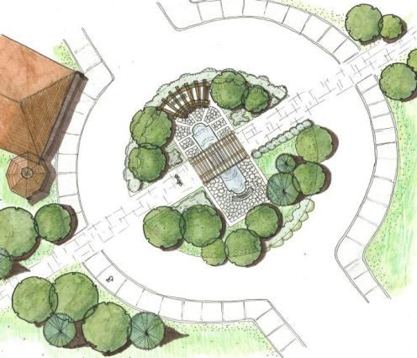
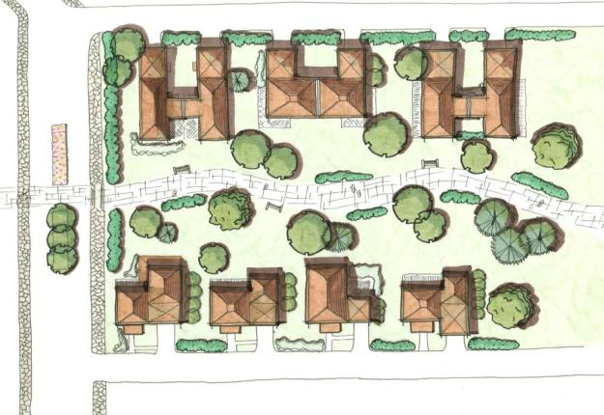
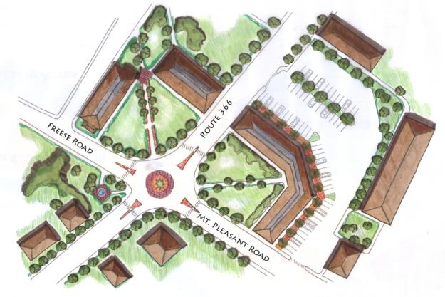
Recommendations & Design Guidelines

Slide 18
Small Area Master Plan and Zoning

Slide 19
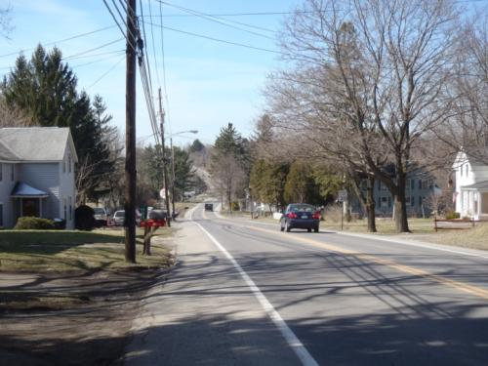
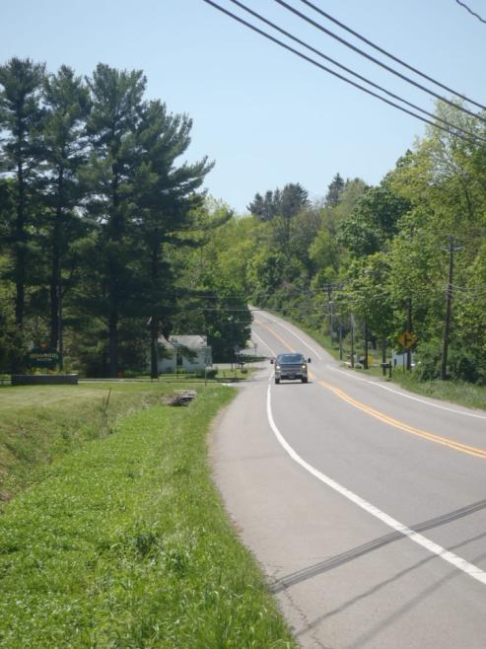
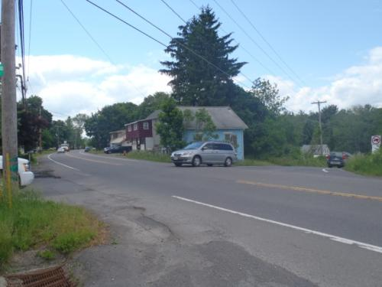
Implementation
Transportation Improvement Program (TIP)

Slide 20
Implementation
Development Proposals

Slide 21
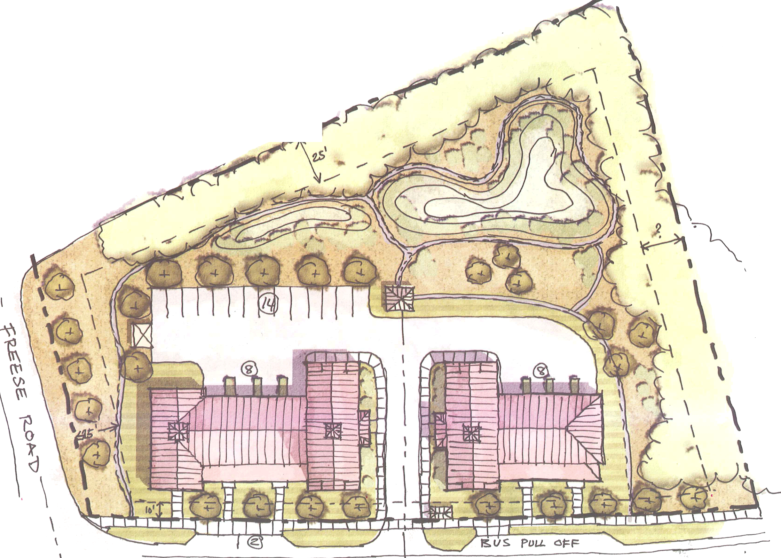
Implementation
Development Proposals

Slide 22
Resources
First, decide what you want!
Comprehensive Plan
Zoning
Design Guidelines
Focused Plans/Area Plans

Slide 23
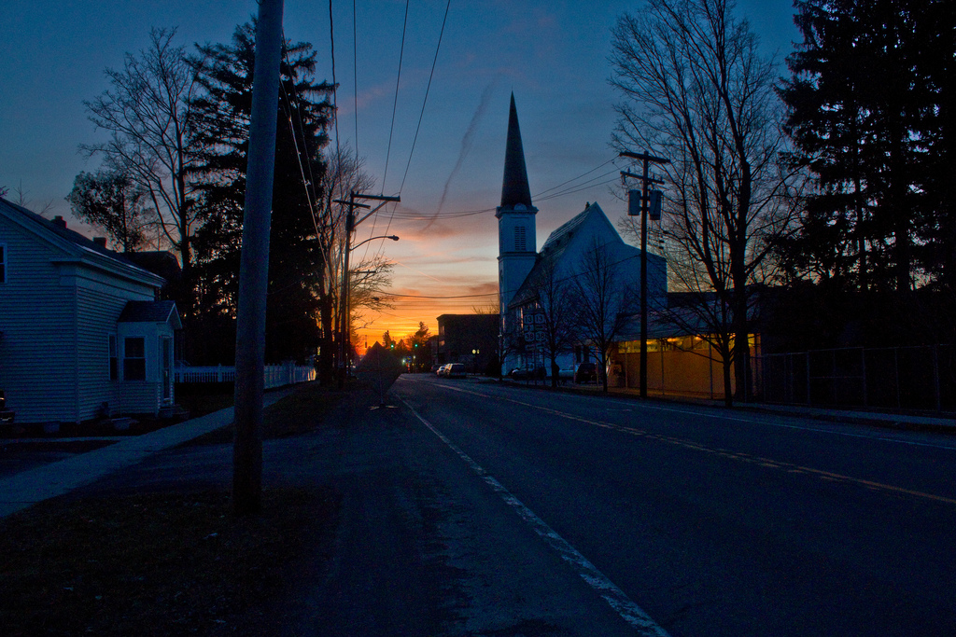
Thank you!
Dan Kwasnowski dan@dryden.ny.us
Jane Nicholson jane@dryden.ny.us
Mary Ann Sumner supervisor@dryden.ny.us

