Slide 1

Growing Green Infrastructure in Central New York through Green Job Training
Virginia Williams
SUNY ESF Outreach
This project has been funded in part by the US Forest Service and CNY Works
Notes:
Hi Everyone, My name is Ginny Williams and I am the interim associate director of continuing and non-credit programs as well as the project manager for a USFS grant that focuses on developing green infrastructure in Central new York. Through this grant, we have developed a green infrastructure training program, or a green jobs green collar program for refugees and the unemployed in Syracuse. The goal of this project is to find synergy between the managing stormwater management in Central New York while also developing a green collar work force, and reinvesting in our place and our people.
We are in the process of wrapping up the pilot offering of our training program, with an eye toward offering it again the mid-spring. What I will present here is the background and status to date of the training program.

Slide 2




Partnerships and funders
Notes:
Really, we have a lot of people who have been involved in the logistics, funding, and planning of this effort. This training program is truly a collaborative effort, especially between the Northside Urban Partnership and SUNY ESF, The USFS, CNY Works, and the Centerstate Corporation for Economic Opportunity
This is one of the things that brought us together today – a lot of good folks working on green infrastructure related projects and workforce development. A special thanks goes to Mr. John Parry who is visiting us from Durham, NH, and was instrumental in helping us secure this grant. Mr. Parry is with the USFS, and is involved in community and urban forestry. Ms. Karen Engel, from the Department of Environmental Conservation in Albany was instrumental in the development of the idea on which this grant is based, and was instrumental in bringing together the right people to the conversation.

Slide 3
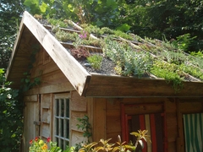
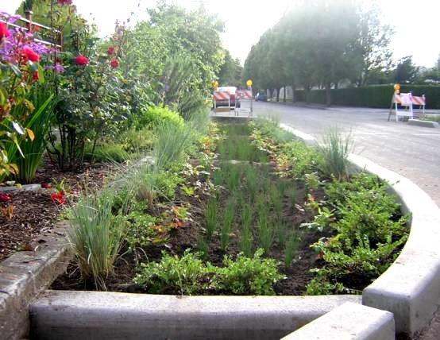
Benefits of G.I.
Reduced & Delayed Stormwater Runoff volumes
Less Pollution in Stormwater
Fewer Sewer Overflow Events
Enhanced Groundwater Recharge
Habitat for urban communities
Aesthetic and human health value
Many more benefits!
Notes:
Green Infrastructure has a lot of benefits, however, most important in Syracuse relate to stormwater runoff.
Green Infrastructure can collect rainwater, reducing the amount entering the sewer system; water that filters through vegetation and soil is cleaned of pollutants; and by collecting and holding this rainwater, green infrastructure can help reduce how often the combined sewer system overflows into Onondaga Creek and Lake.
Other benefits included: Decreasing urban heat island impacts and thus reduced energy, Improved Air Quality and human health, Additional Wildlife Habitat & Recreational Space, and Increased Land Values

Slide 4
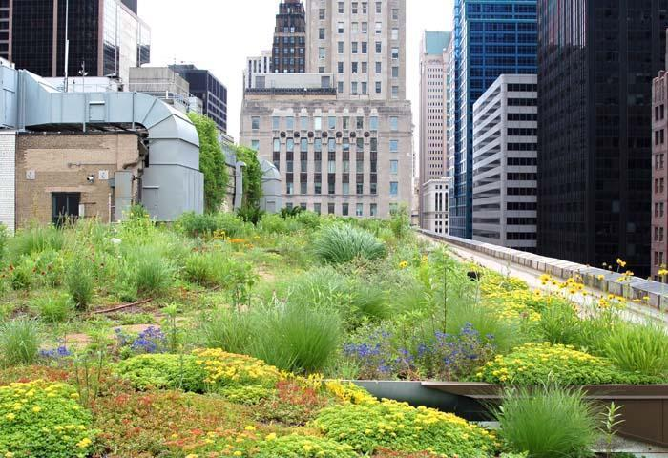
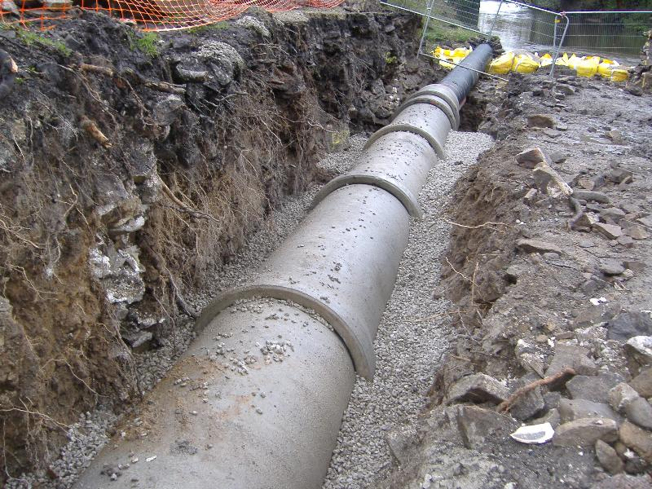
Why Green Infrastructure Training in Central New York?
By Dec 31, 2018 the Onondaga system must capture 95% of all stormwater (they currently capture about 84%)
Green Improvement Fund – apply for project funding in Clinton, Harbor Brook and Midland Sewersheds
Notes:
Per federal mandate, by 2018 the stormwater management system in Syracuse must capture 95% of all stormwater, as opposed to the 84% they now collect. In order to achieve this, the county will be implementing a combination of grey and green infrastructure.
A great deal of money will be put into the design, implementation and monitoring of green infrastructure in the next 8 years and beyond. How can be best maximize the benefit to the community, keeping the jobs and money local, employing our CNY residents.
Additionally, how can we help developing a cohort of trainees with the knowledge, skills and abilities to make this all happen? This is one of the unifying questions of this overall effort.

Slide 5
Green Infrastructure Training
Project Goals
  Create a successful local “green-collar” workforce program
  Build a replicable job training model for urban neighborhoods
  Address poverty and unemployment
  Support local green businesses and industry
  Promote environmentally sustainable development
  Revitalize and reinvest in the physical infrastructure
  Invest in our community and our human capital
Notes:
Karen Engel, who is visiting us from Albany, and will be one of our featured speakers tomorrow AM, helped to create this idea and bring it into fruition. This program grew out of her original vision, to create a green job training program focused on green infrastructure here in Syracuse.
5

Slide 6
Green Train @ The Northside Urban Partnership
Successful construction training program specializing in weatherization and energy auditing
Work with mostly refugee populations
Recruitment and workshop process
Case management
Job placement
Notes:
The northside Urban Partnership is really the group that are the masters of the process in workforce development. SUNY ESF is masters of the content, with our faculty and staff that do research and design work related to green infrastructure and landscaping.

Slide 7
Green Infrastructure Training
Green Train Landscaping and Urban Ecology Program
Training program developed by SUNY ESF in collaboration with the Northside UP
Instruction delivered by experts in the process and content of green infrastructure and education
10 weeks of hands- on and instruction

Slide 8
Programming core content
Northside Collaboratory, locations throughout CNY
8 weeks
Experiential Internships
with landscaping design and contracting, nursery, and green infrastructure employers in CNY
2 weeks
Programming introduction, team building
Program
Pre-screening
SUNY ESF, Northside Urban Partnership
Program Graduation
SUNY ESF, Northside Urban Partnership
Introduction to stormwater management
Gardening and landscape design (2 weeks)
On-site supervision
Residential green infrastructure applications
Hands-on training
Urban green infrastructure applications
On-the-job learning
Work preparedness skills and soft skills
Certifications
ESF Certification of completion
OSHA 10-hour
Notes:
10 week training program
The learning outcomes:
Knowledge, skills and abilities in landscaping and green infrastructure design, building and maintaining
We want them to understand the green of green infrastructure – the plants and the soil, the natural processes. Thus, we spend a fair bit of time
We also want them to understand that people are a part of green infrastructure, the design and how things look impact how well it is received
We want them to have the hands on experience to do this on their own, to design and build

Slide 9
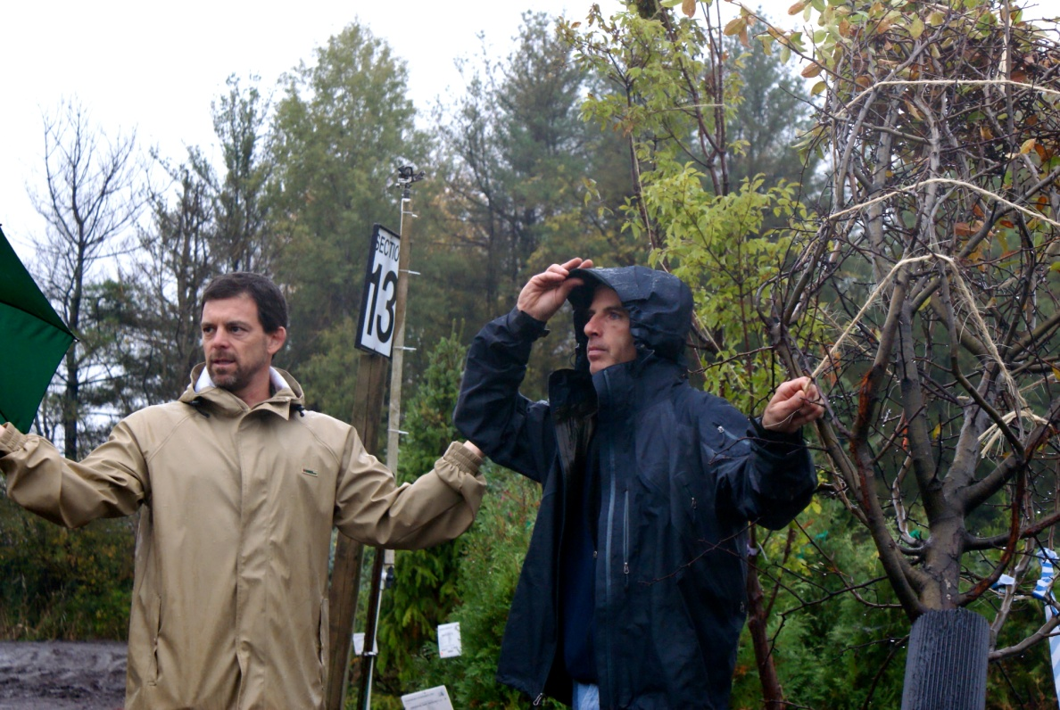
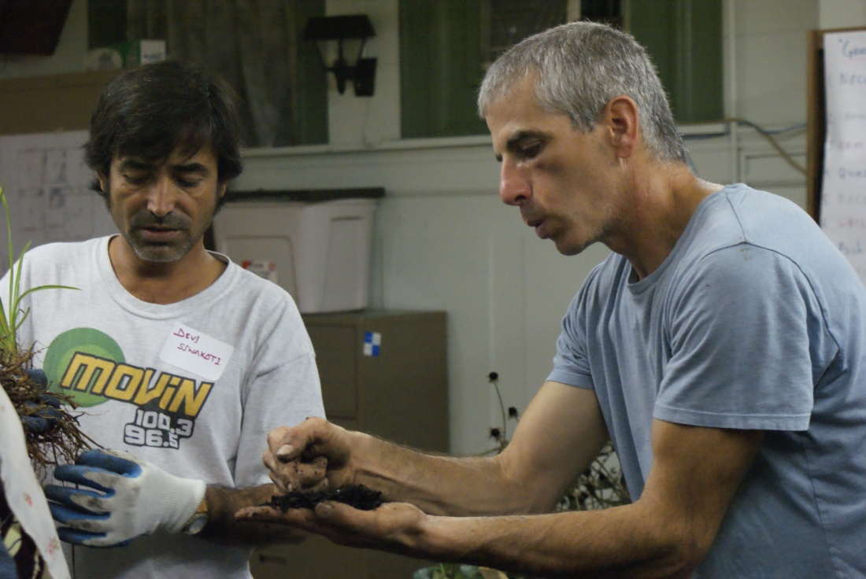
Landscaping Design and Build
Instructors:
  Dan Reeder, Adjunct Professor, SUNY ESF and Greenscapes Landscaping Design
  Dan Carroll, Liverpool Central School District

Slide 10
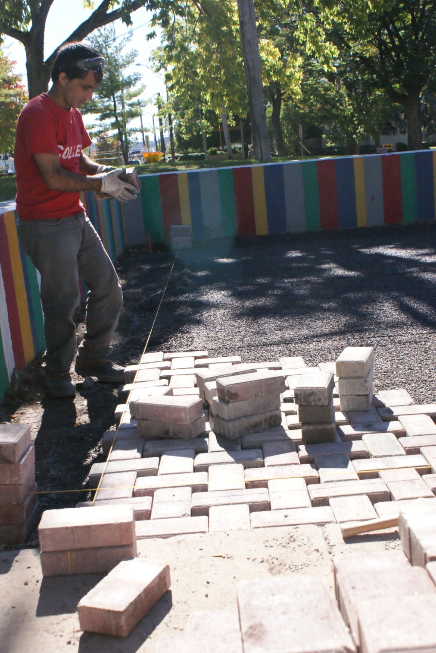
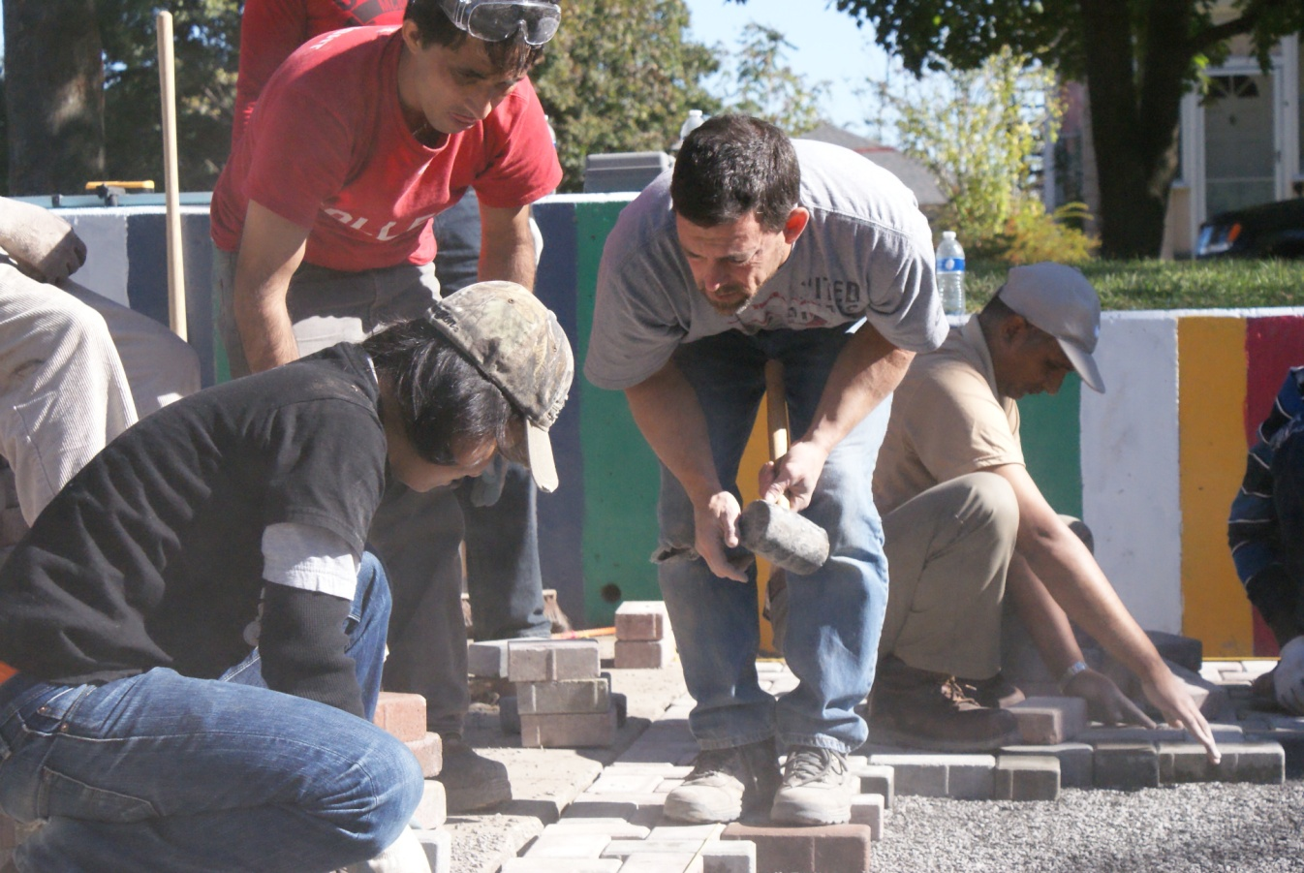
Principles of landscape design

Slide 11
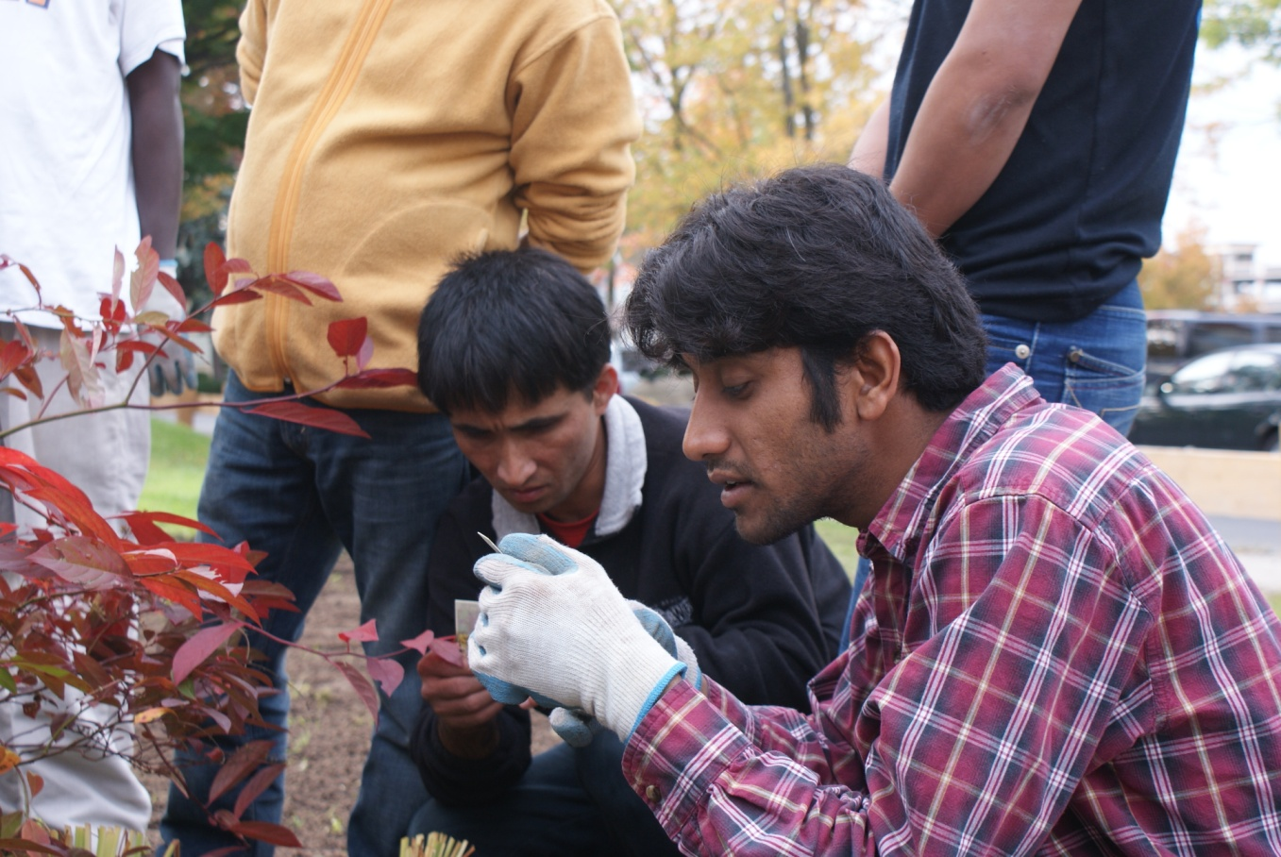
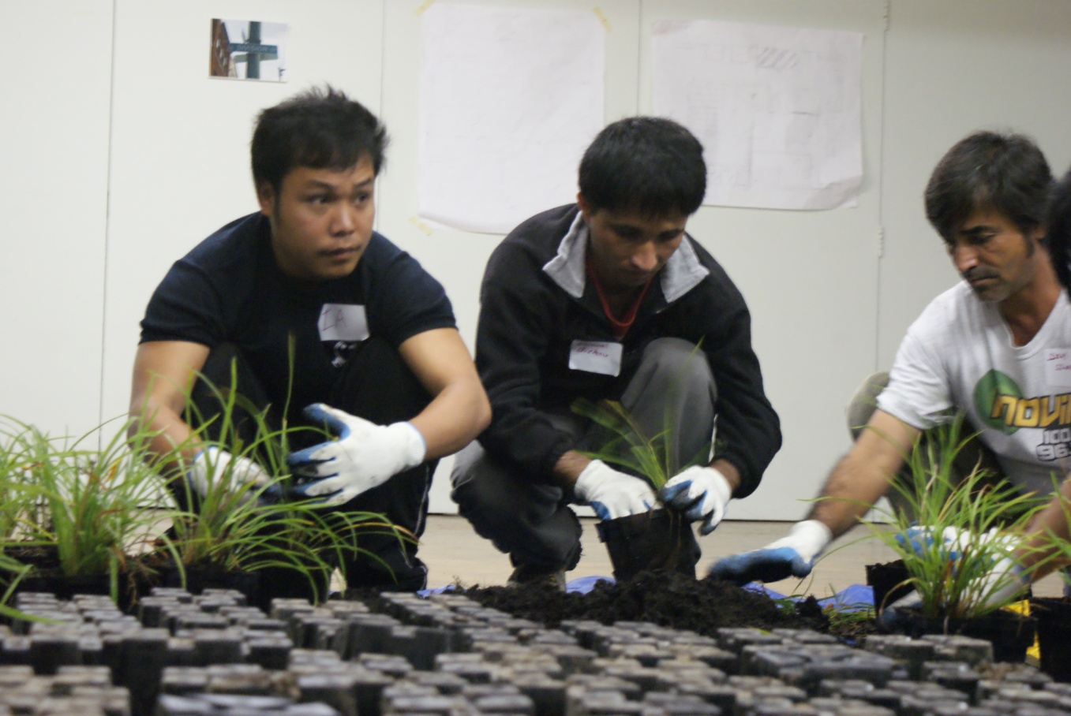
Principles of urban forestry, soils, horticulture
Notes:
Learn about native plants, soils, habitat, urban forestry, and hardscaping

Slide 12
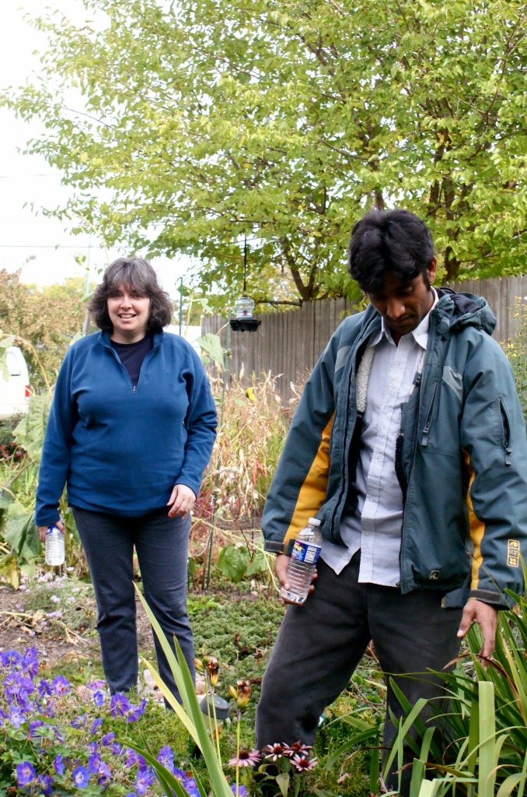
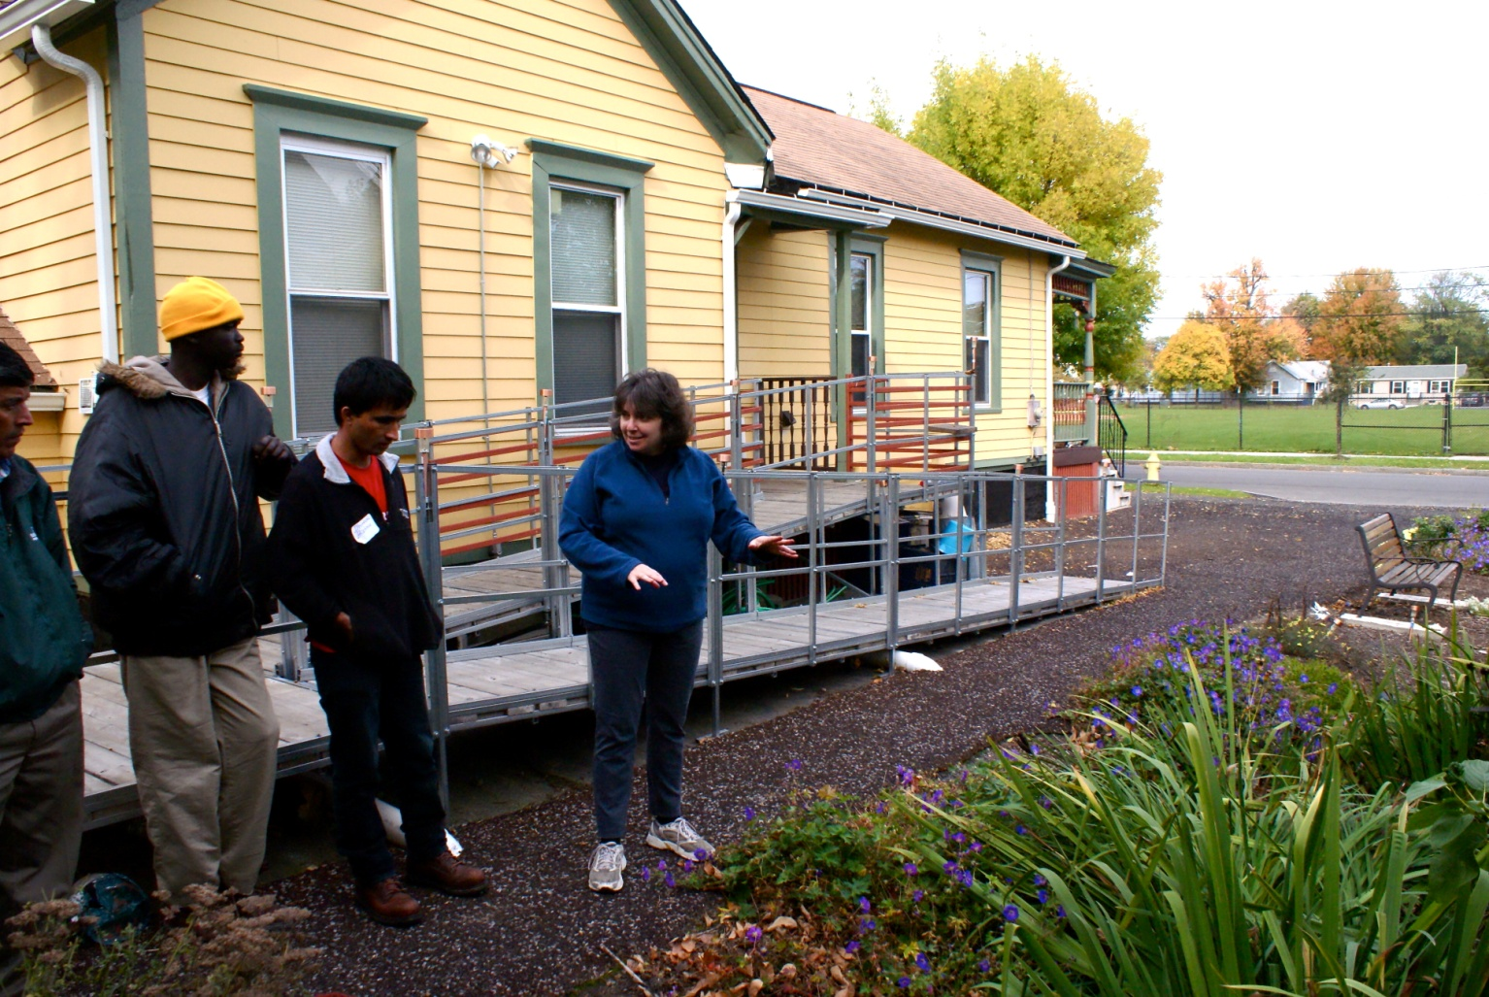
Residential Green Infrastructure Design and Build
Instructor: Amy Samuels, Onondaga Environmental Institute
Notes:
The Onondaga Environmental Institute is a non-profit organization whose mission is to advance environmental research, education, planning, and restoration in Central New York.
Rain gardens
Rain barrels
Site testing and preparation
Hands-on projects: Design and installation opportunities
Various site visits

Slide 13
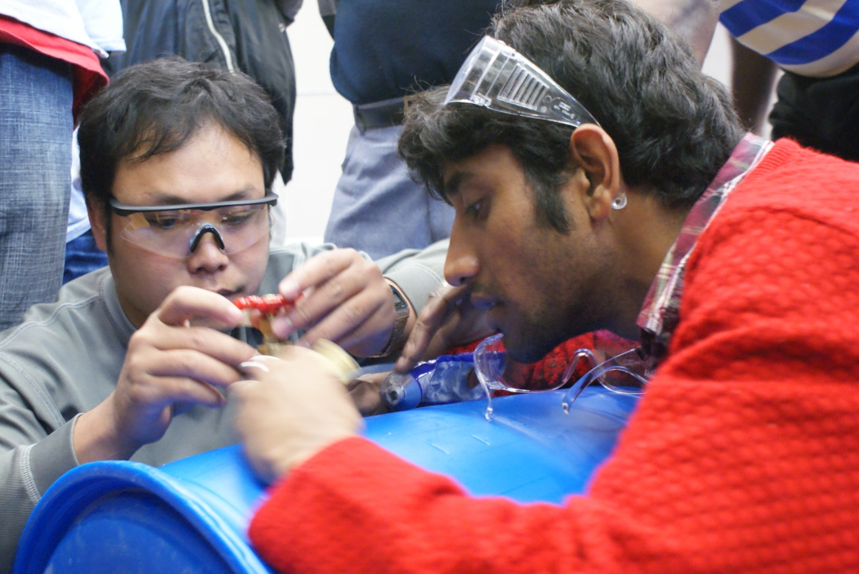
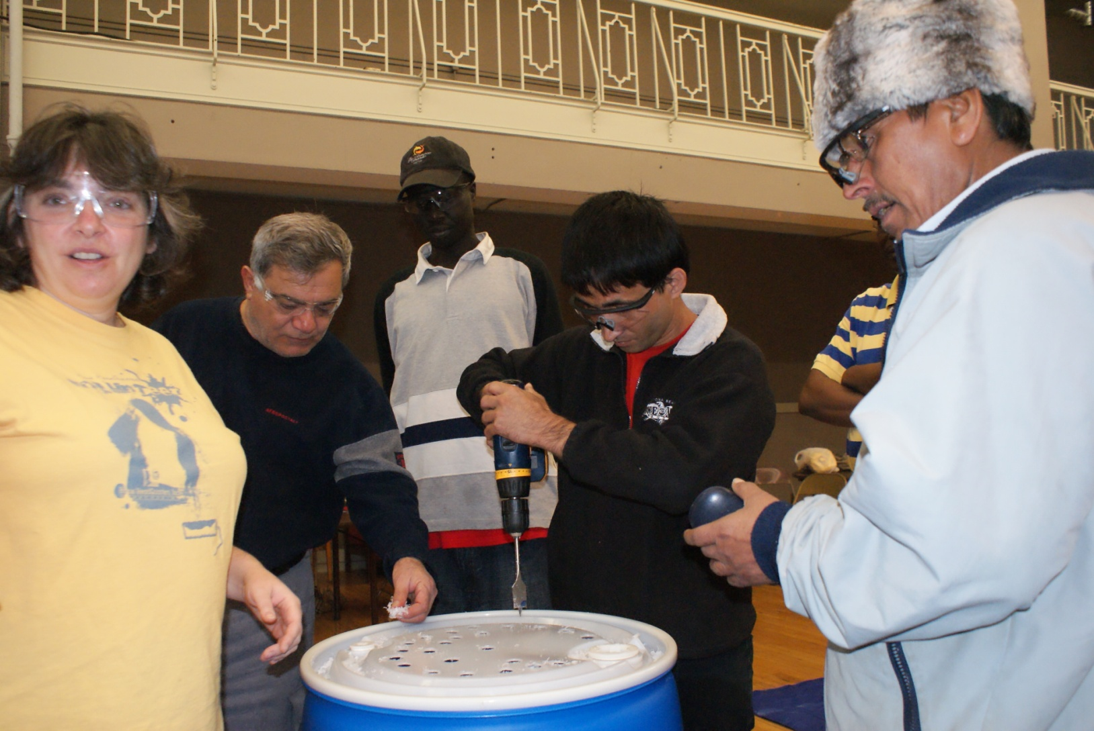
Build and install rain barrels

Slide 14
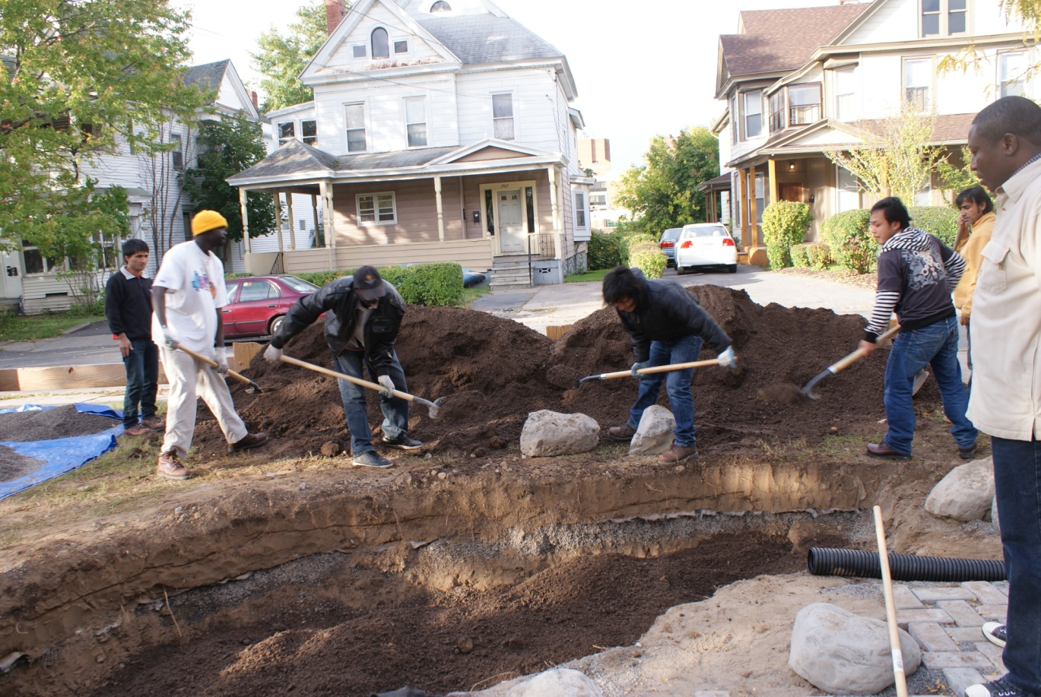
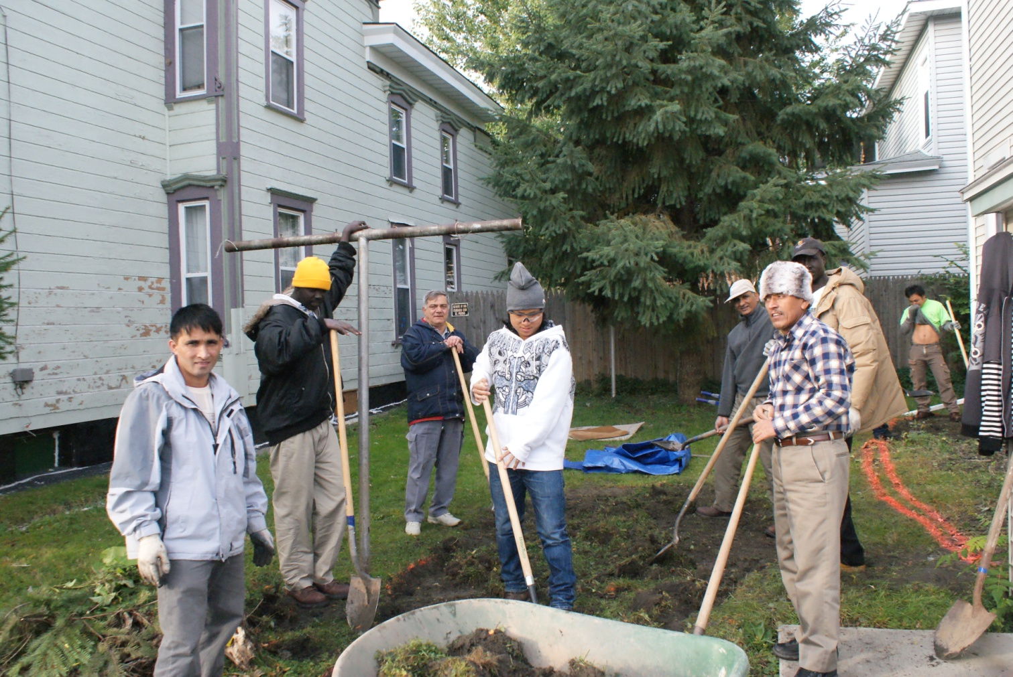
Design and build rain gardens
Site Assessment and sizing

Slide 15
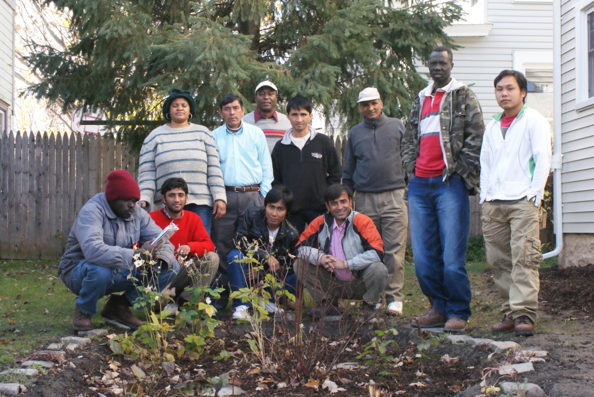
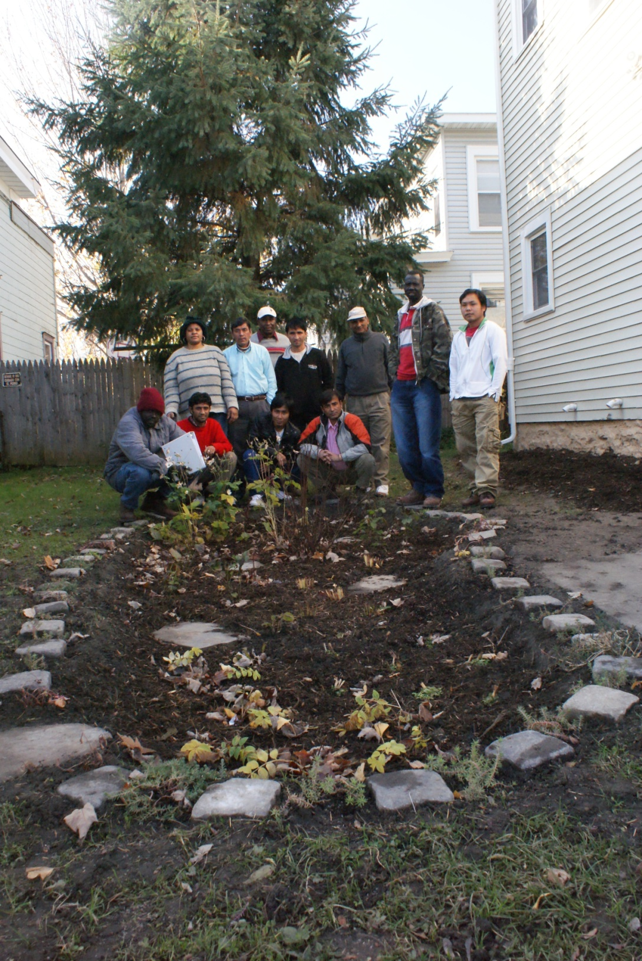

Slide 16
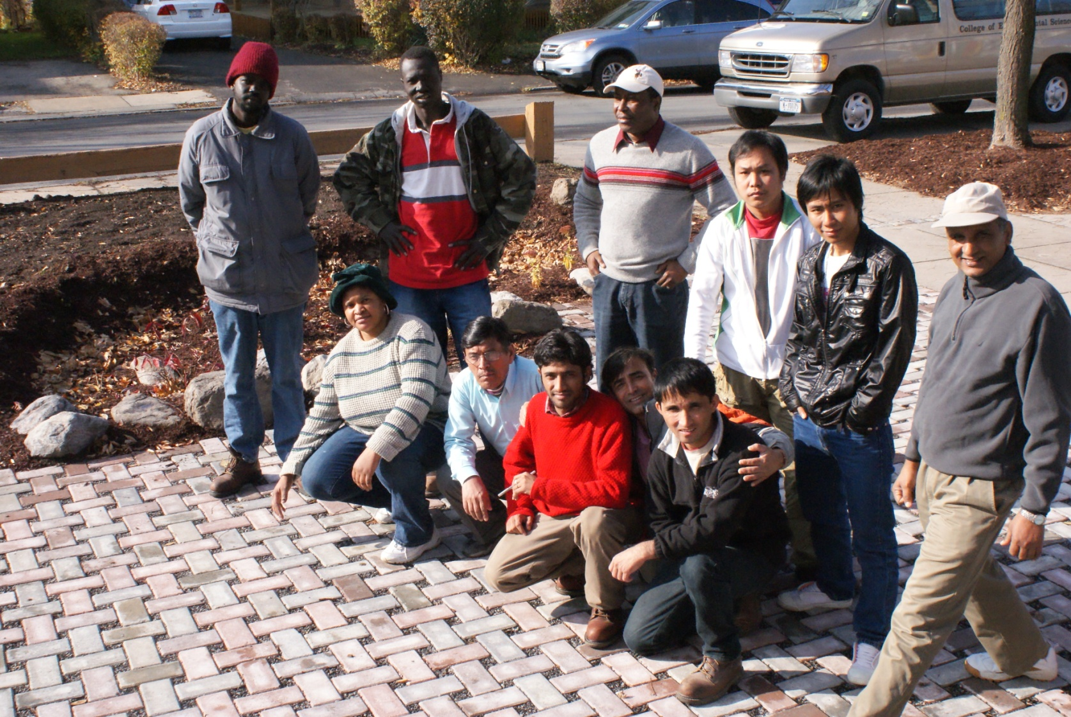
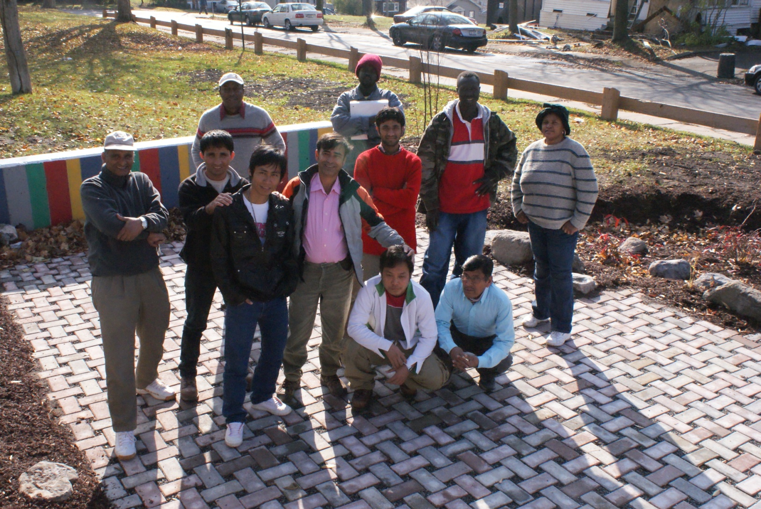

Slide 17
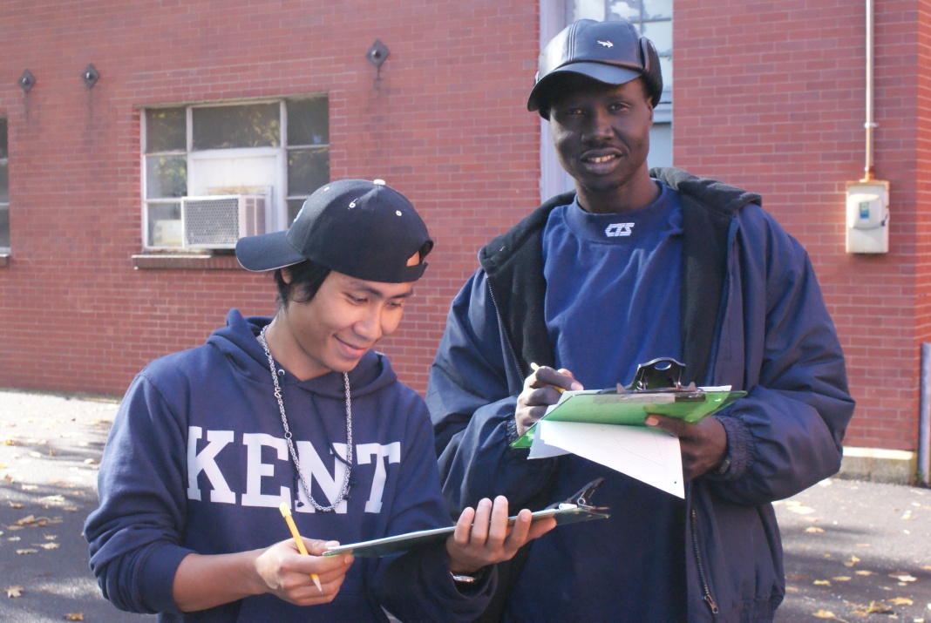
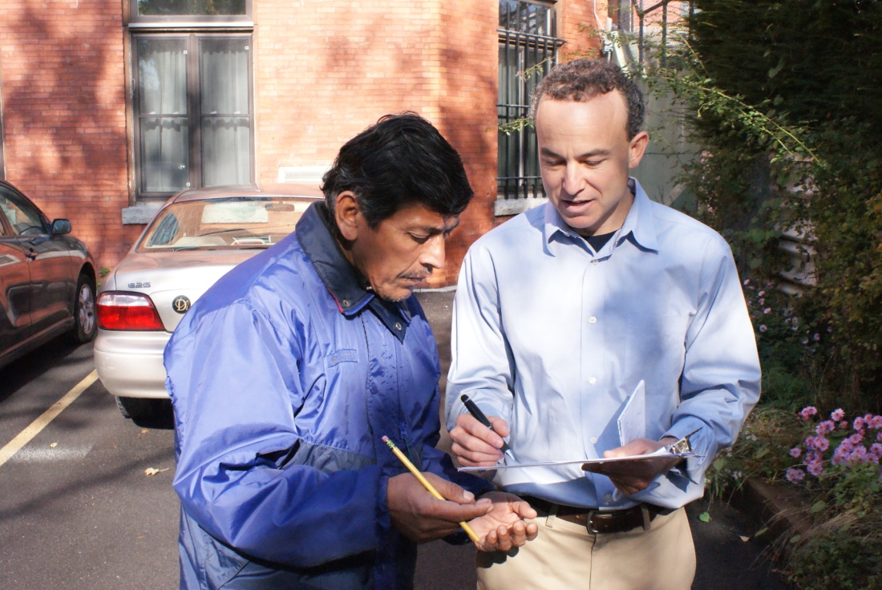
Engineering Design for
Green Infrastructure
Instructor: Dr. Ted Endreny, Professor, in the Environmental Resources Engineering Department at SUNY ESF SUNY ESF

Slide 18
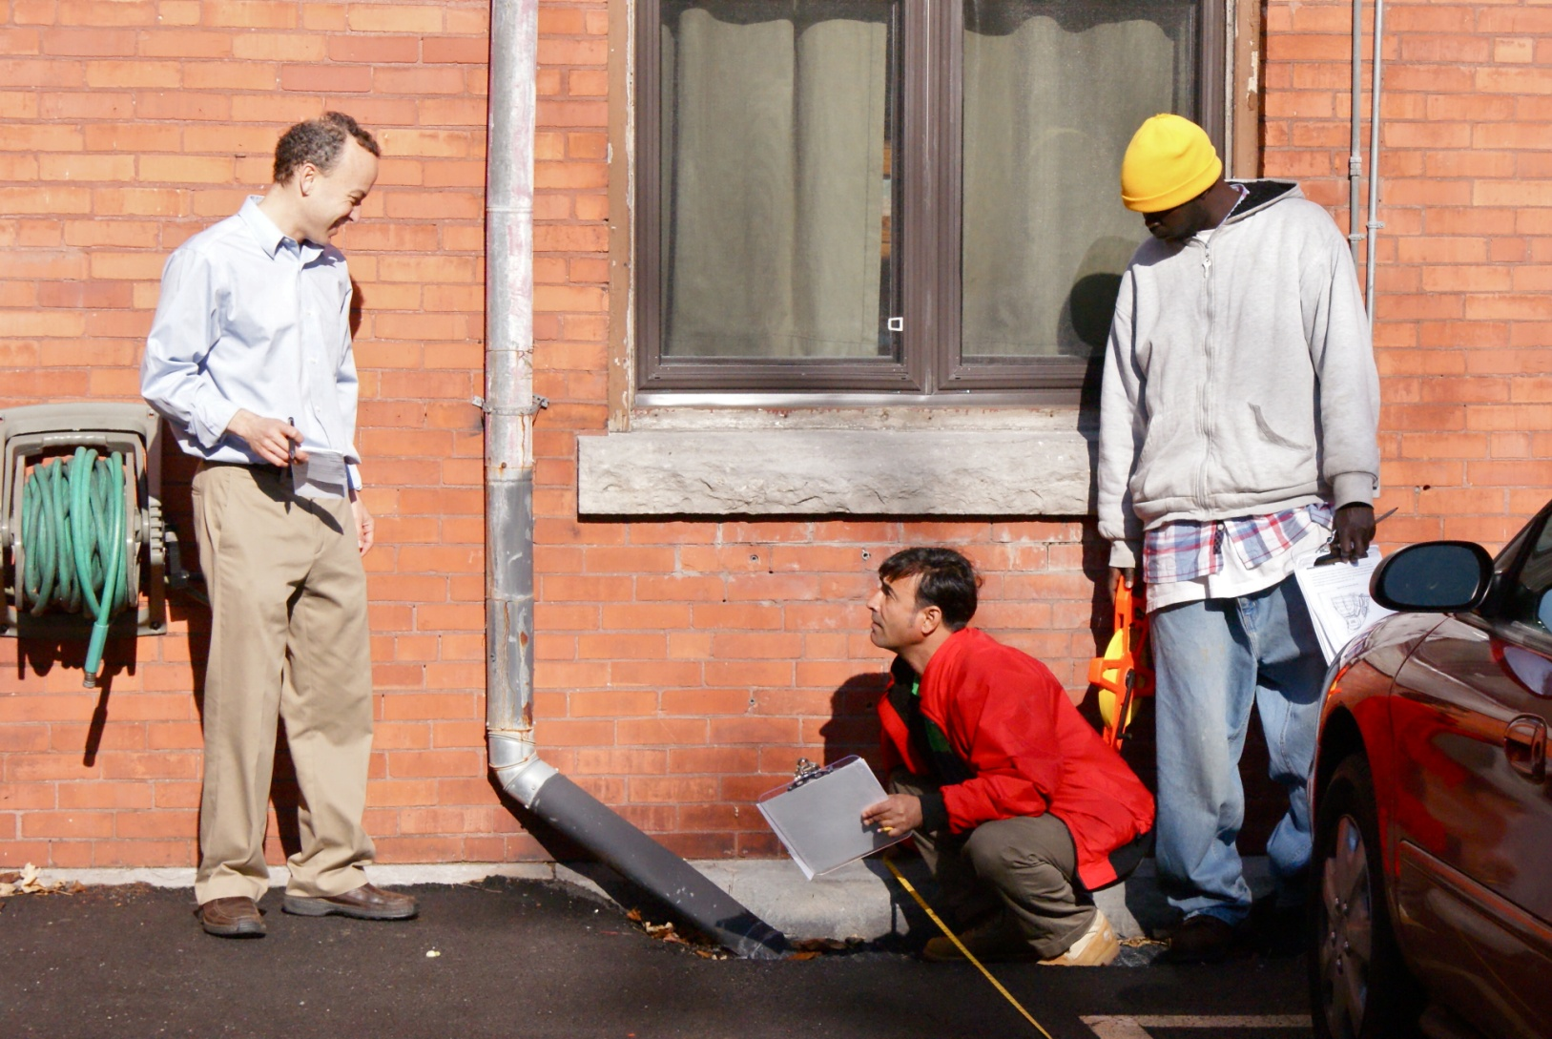
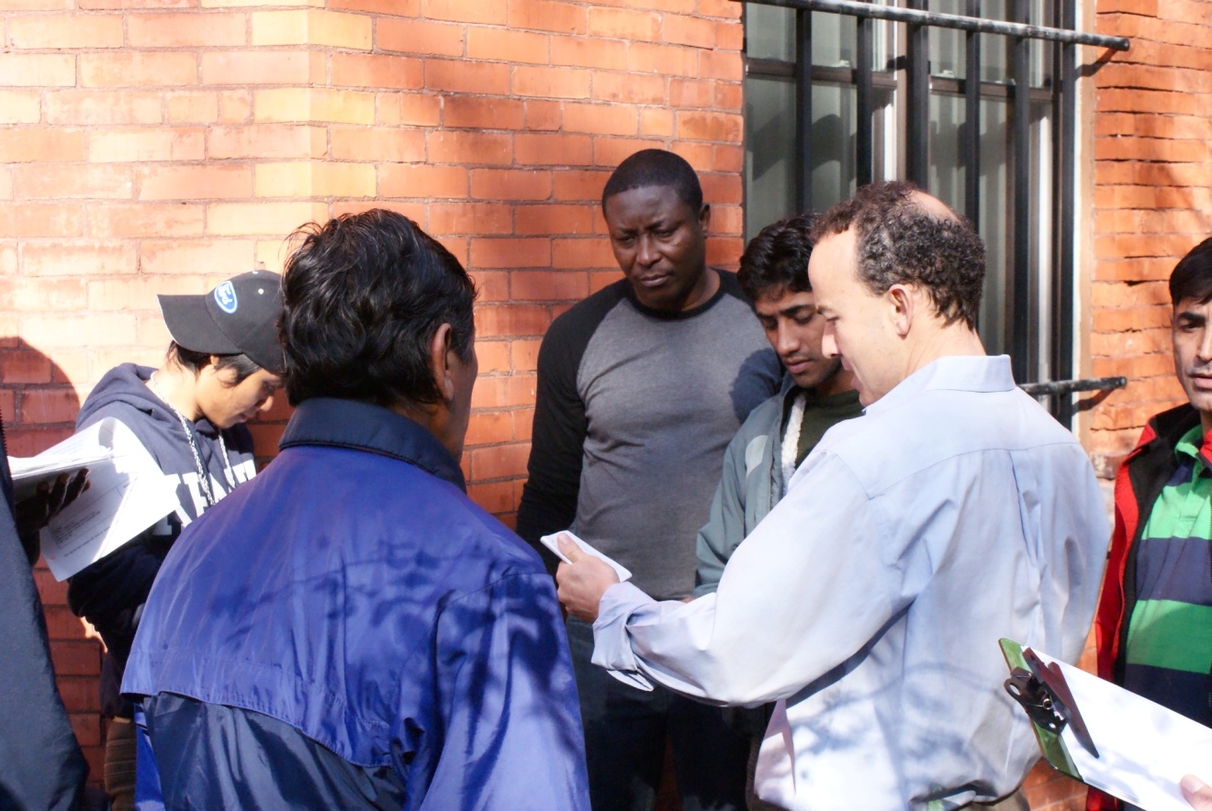
Design and Engineering
Notes:
Our students went through the New York State stormwater design manual for bioretention basins to learn how professionals design these installations, and the steps in the design.

Slide 19
Soft Skills
English as a second language
Job readiness (resume, interviewing)
Work place communication
Financial literacy
Teambuilding
OSHA 10-hour training
Notes:
Many prospective employers that I interacted with early on in the development of this training told me – Give me someone with a positive attitude and a good work ethic, and I will teach them most of what they need to know. I think we can all appreciate this idea. However, we can do better than that, and we can give you a hard working person with knowledge and experience in some important areas of green infrastructure, landscaping, and design.
This is one of the things that our partners, the Northside Urban Partnership, have imbedded into their program from the beginning, a very solid softskill program, and through partnering in this effort, created a technically and instructionally robust program, with the appropriate wrap around skills

Slide 20
Internships
All students placed in a 2-week internship
Landscaping design and build firms
Landscaping
Nurseries and gardens
Develop relationships with industry

Slide 21
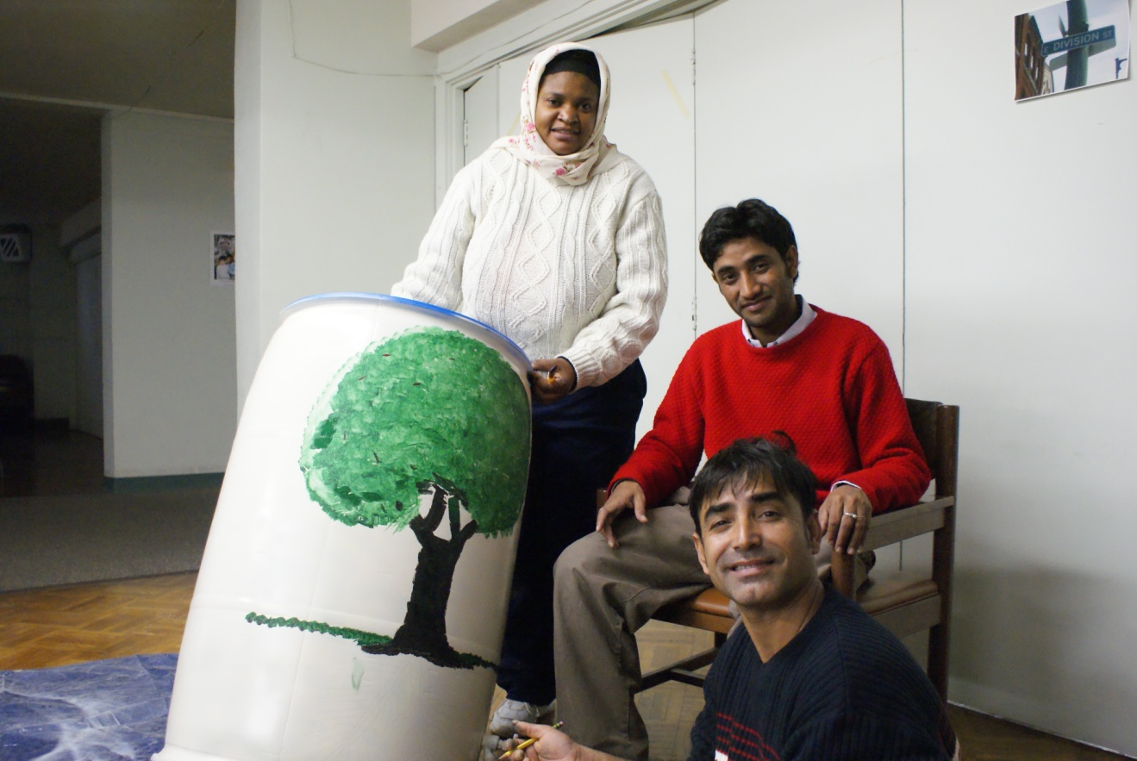
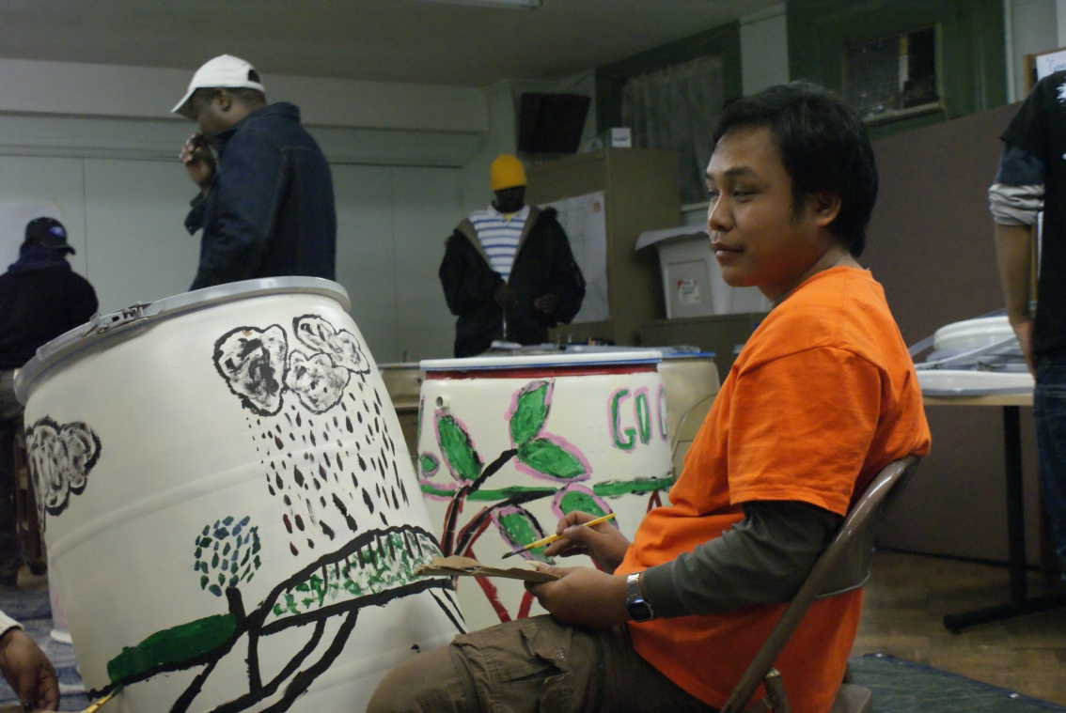
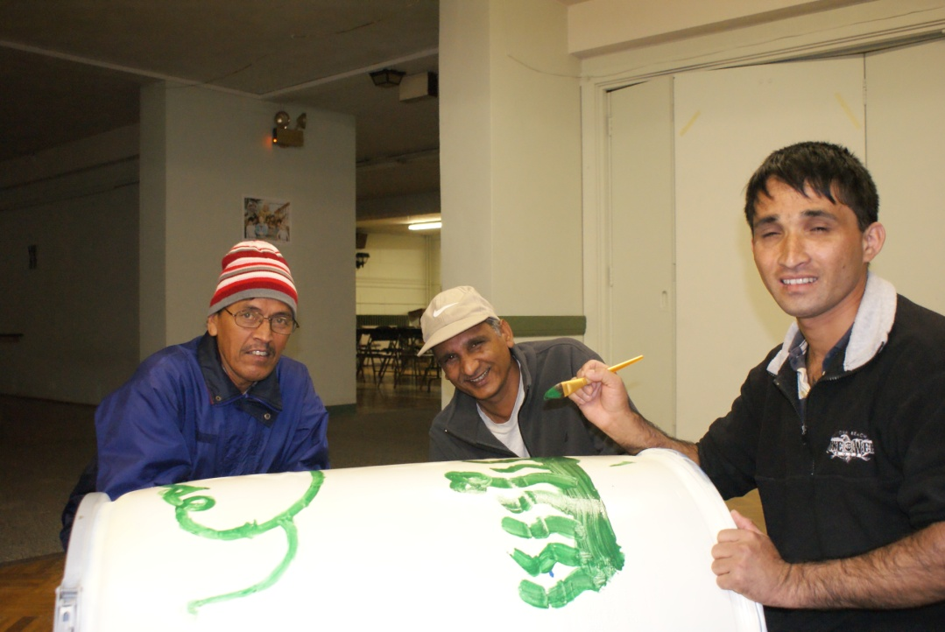
And to hopefully have some fun along the way!

Slide 22
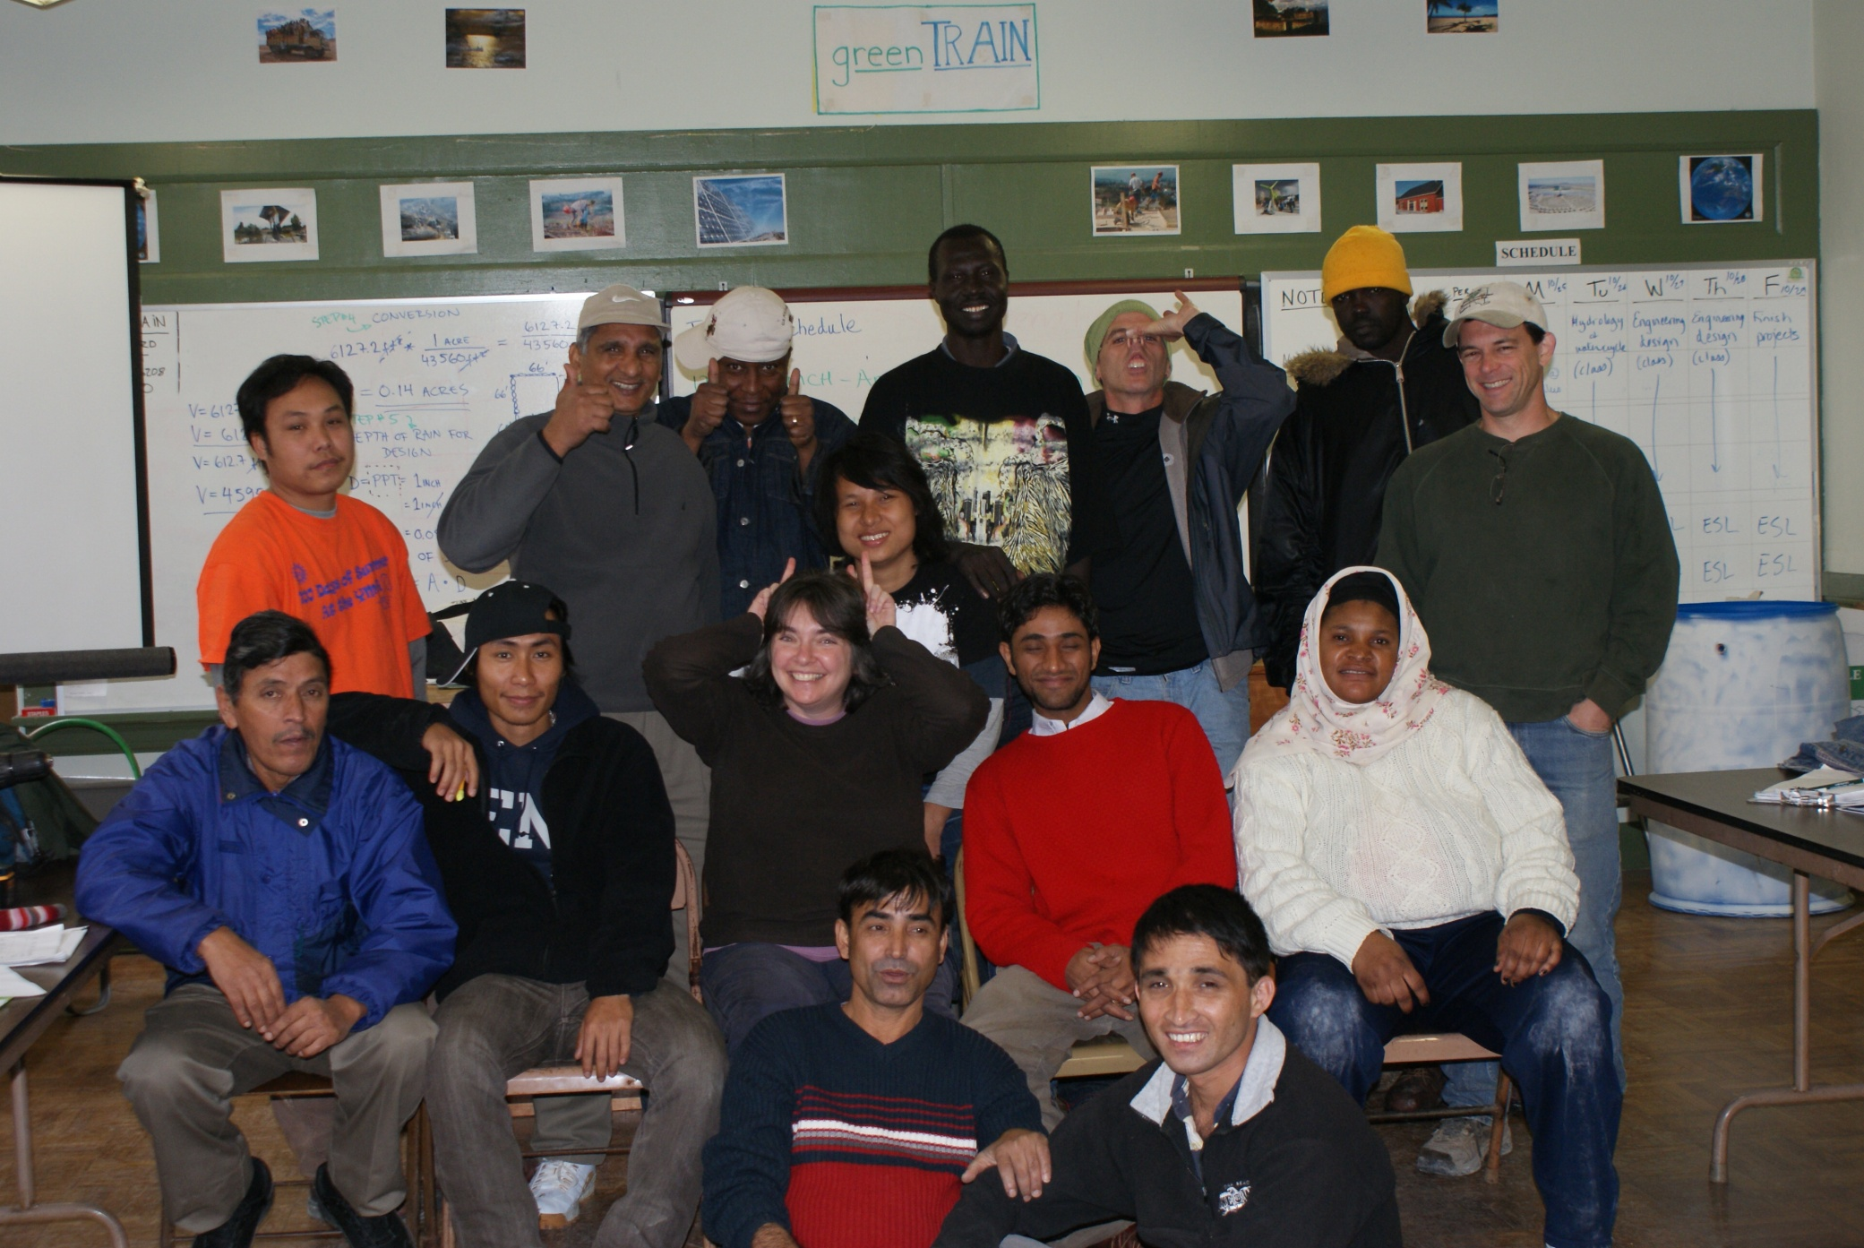

Slide 23
All while working towards these project goals:
  Create a successful local “green-collar” workforce program
  Build a replicable job training model for urban neighborhoods
  Address poverty and unemployment
  Support local green businesses and industry
  Promote environmentally sustainable development
  Revitalize and reinvest in the physical infrastructure
  Invest in our community and our human capital
Notes:
Karen Engel, who is visiting us from Albany, and will be one of our featured speakers tomorrow AM, helped to create this idea and bring it into fruition. This program grew out of her original vision, to create a green job training program focused on green infrastructure here in Syracuse.
23

Slide 24
Project status to date
Core content in class and field based training completed
Students internship completed
Wrapping up remaining training
Graduation December 3rd
They will join us again for the AM tomorrow, so please say hi!
Notes:
Now this pilot offering of the program is almost complete, and the students will be graduating on December 3rd.

Slide 25
Next Steps
Preparing to offer program again in the spring
Develop additional programming for other audiences
  Professional design and landscape green infrastructure modules
  Other audiences, including K-12
Making it better every offering every time

Slide 26
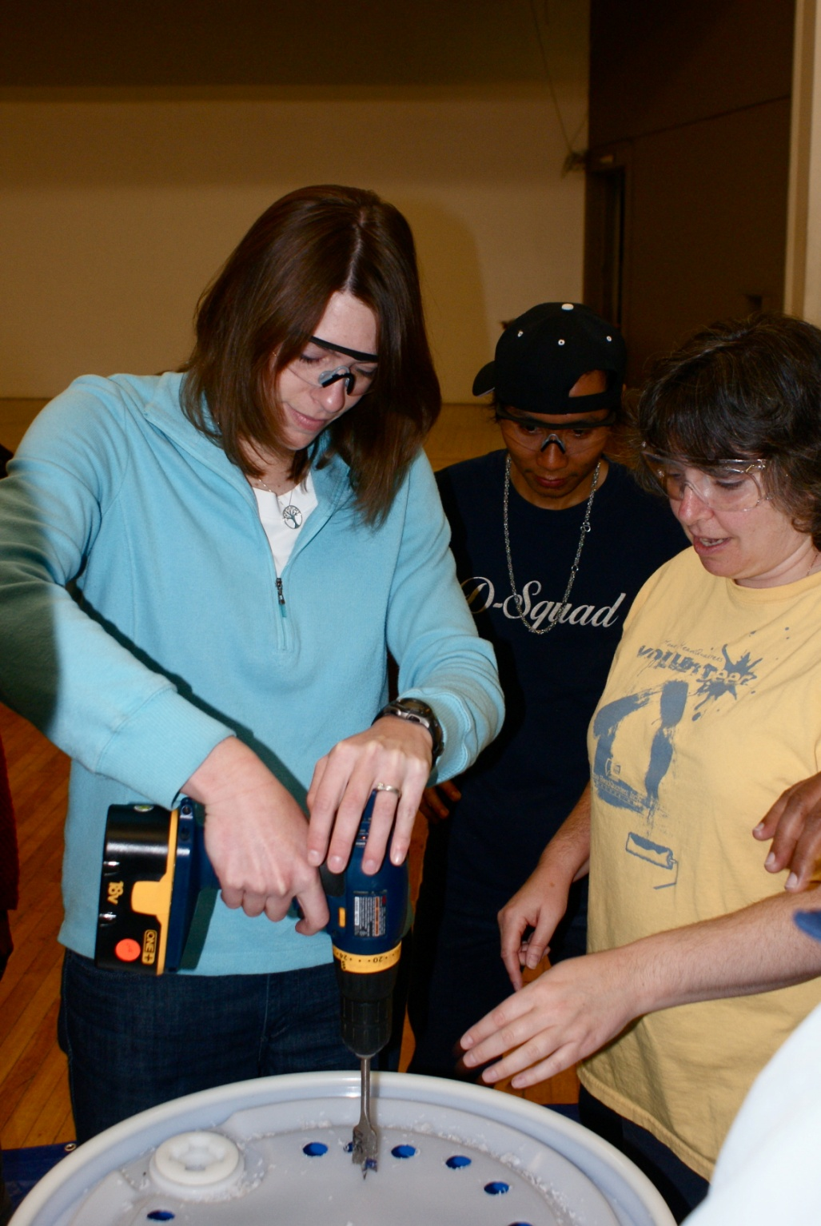
Notes:
And really none of this can be achieved without really great support staff, and your partners who help make it happen.

Slide 27
Any questions?
For more information, please check out the project website:
  www.esf.edu/outreach/gi/
    Green Infrastructure Initiatives at SUNY ESF in research and demonstration
    More information about our Green Infrastructure Training Program
    Green Infrastructure Symposium 2010
    More to come!
    We are helping to grow green infrastructure in CNY and NYS!
This project has been funded in part by the US Forest Service and CNY Works

