Slide 1
Building within Ecosystem Boundaries

Slide 2
Ecological Performance Standards
To guide and Inform for building within ecosystem boundaries
A road map for site specific, ecologically sound building

Slide 3
Not a rating system
Based on performance
Build environment as part of a functioning ecosystem
Site specific guidelines
Reproducible process

Slide 4
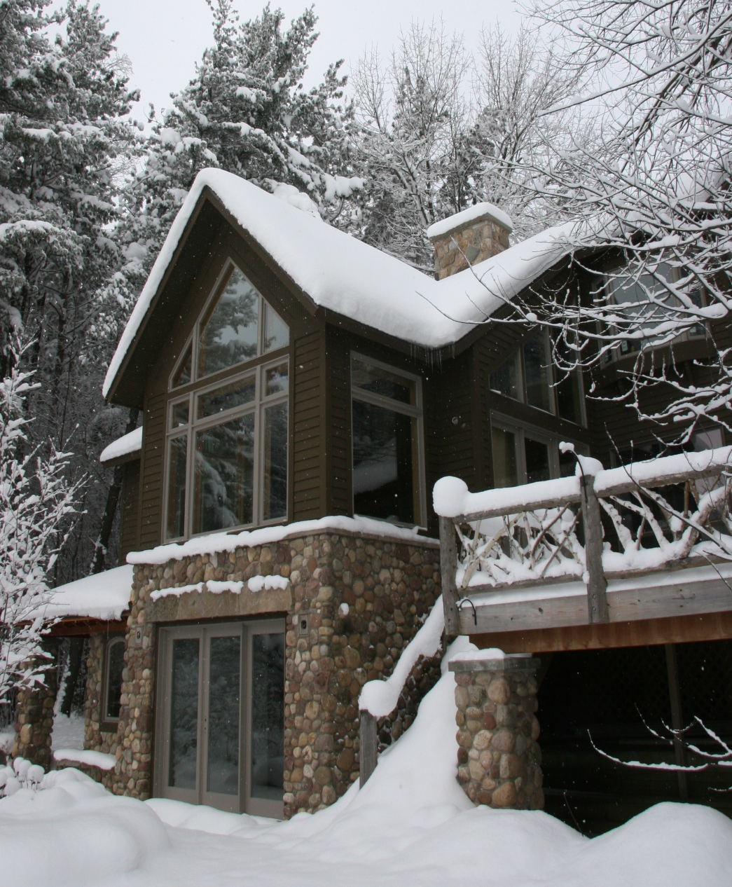
Holistic design rather then efficiency alone
Sequestering carbon
Tree plantings, 50-60 trees a year
Purifying water
1200 gal. Cistern: flushes toilets, exterior spigots
Reprocessing waste on site
Salvaged material
Habitat creation
Notes:
No heating system 19 yrs. passive solar

Slide 5
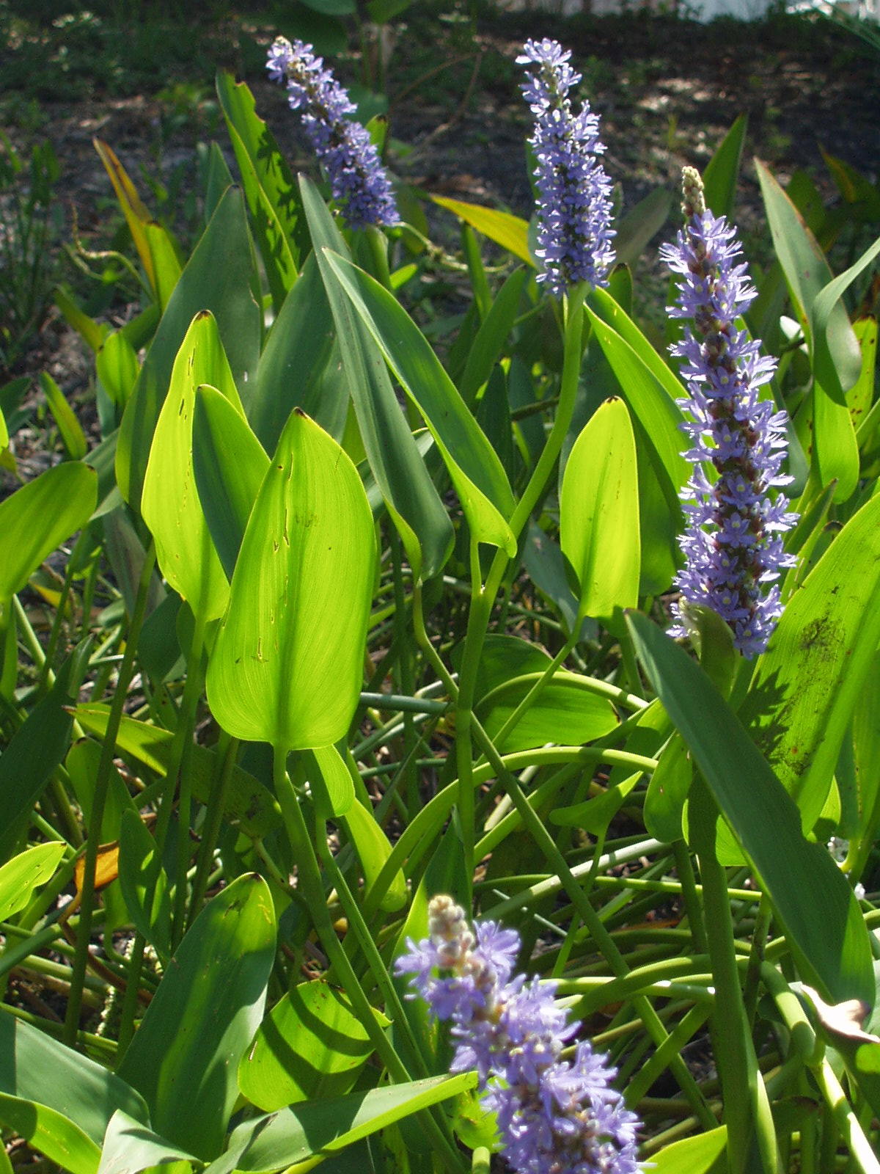
Goals
Stay within the biological and abiotic boundaries
Manage for regeneration, succession, and resilience
Preserve and enhance the patterns of a functioning ecosystem
Pickerelweed, Pontederia cordata

Slide 6
Case study: 319 Marcellus

Slide 7
Step 1: Site Assessment
Historical maps
Geographical information system (GIS) mapping: climate, soil, land cover, hydrology
Traditional and local ecological knowledge

Slide 8
Historical Ecosystem
Notes:
First account of ecosystem was the TEK account of the Onondagag nation, this was a fishing port used to launsh canoes, for salmon, whitefush, eel. Too marshy to live, used as a natural resource, but they lived on the surrounding hills. Onondaga means people of the hills

Slide 9
Salt sheds, Creek channelization 1800’s -1900’s

Slide 10
Digitized 1790 Vegetation survey
Dr. Myrna Hall

Slide 11
Current Street Grid

Slide 12
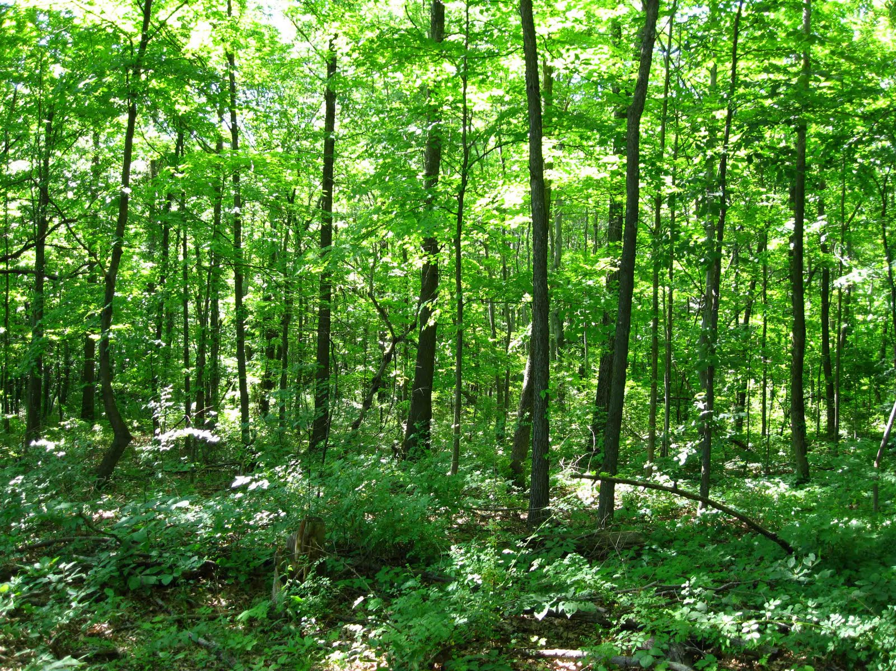
ecological monitoring to guide design

Slide 13
Step 2: Surveys and ecological monitoring
Energy
Micro-climate
Atmosphere
Wildlife communities
Water quality,
Bio-Productivity
Soil
Community connectivity/food web
Human Health
Notes:
.

Slide 14
Energy Resources

Slide 15
E.P.S: Energy use
4.03 kwh/m² /day in available solar resources
E.P.S: 2,770.3 kwh/day energy in total
Average U.S household: 8,900 kwh/yr
Only 24 kwh/day
Solar thermal and PVC
Passive solar design
High efficiency and natural lighting
Deciduous shade trees

Slide 16
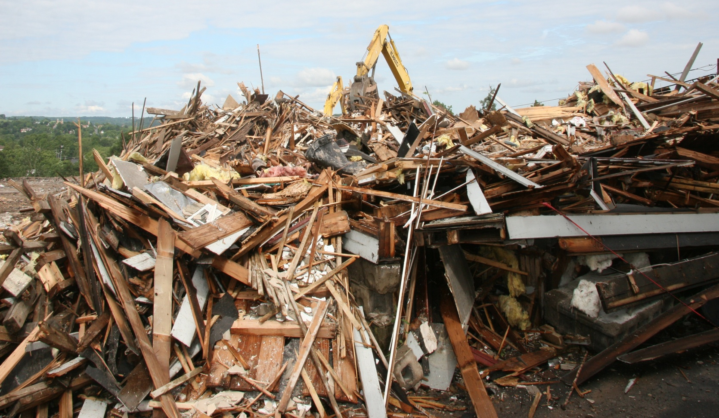
Carbon cycle
E.P.S: 1,653 lbs of CO² /yr stored on site
Avg US citizen produces 24 tonnes/person yr.

Slide 17
Alternatives

Slide 18
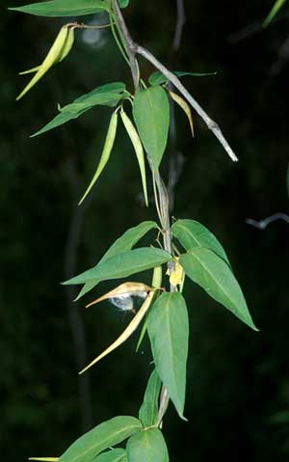
Vegetation
Plant surveys and seed bank studies to guide management
Vincetoxicum nigrum

Slide 19
E.P.S: Creation of wildlife habitat using native species and natural structures for breeding, nesting, and foraging.
Eastern Hemlock (Tsuga canadensis)……………Tannins for leather industry, Timber,
Red Maple (Acer rubrum)……………………….. Syrup, Tonewood for instruments
Yellow Birch (Betula alleghaniensis) . ……….Lumber for furniture, cabinets, Firewood
Black Ash (Fraxinus nigra) ………………………. Basket-making, Firewood
Tamarack (Larix laricina)……………Straight timber for ship masts, posts, railroad ties
Eastern White Pine (Pinus strobus)………………. Medicinal tea, Timber

Slide 20
Water Cycle
E.P.S: 257 gallons per day gallons water absorbed and purified
40” rainfall and 115” snow received per year.
rain gardens
bio-swales
rain water re-use
gray-water purification and re-use,
tree plantings,
green-roof,
rainwater-fed toilet

Slide 21
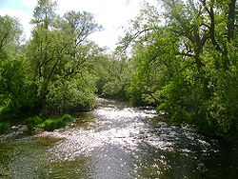
>100 Sp. Fish
Reduced to
12 sp. in 1950
Fishing banned in 1970.
White fish, salmon, eel, regionally extirpated

Slide 22
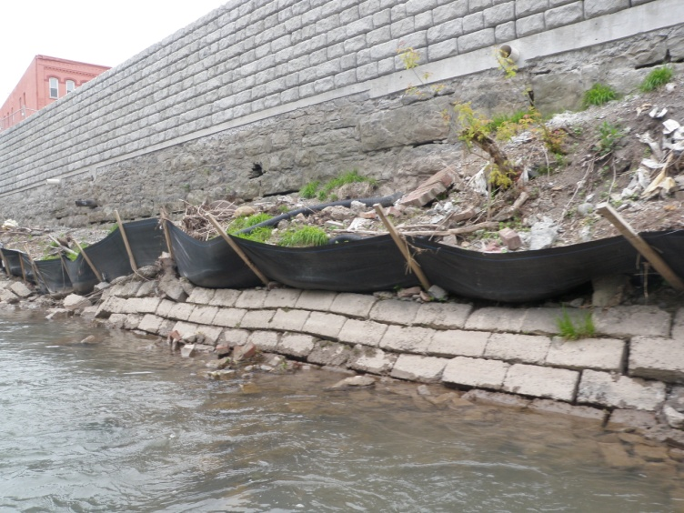
Water quality improvements through design
Rainwater capture,
pervious surfaces,
no pesticides
no chemical fertilizers
infiltration techniques
permanent erosion control

Slide 23
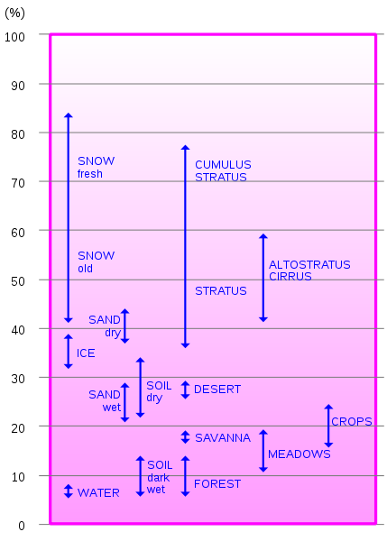
Micro-climate
E.P.S: Emissivity of site averaging
between .96-.97.
E.P.S: Albedo falls within
the range of .17-.20 .
Appropriate roof coloration and
material, reduce or eliminate
impervious surfaces, tree plantings

Slide 24
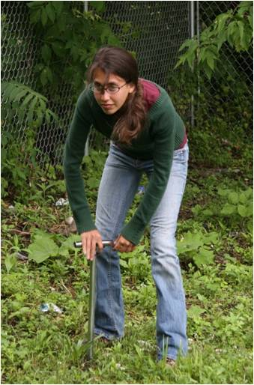
Bio-productivity
E.P.S:
Soil testing
Soil building practices
food scrap composting,
layer composting
On-site food production

Slide 25
Step 3 Address Limitations
Changes in hydrology
Urban soils
Depleted seed bank
Zoning
Invasive species, mychorizal changes

Slide 26
Solutions
Bridge species
Adapting standards for modern conditions
Succession and dynamic equilibrium of site
Staying within the ecological boundaries of reference ecosystem…….is not a restoration project

Slide 27
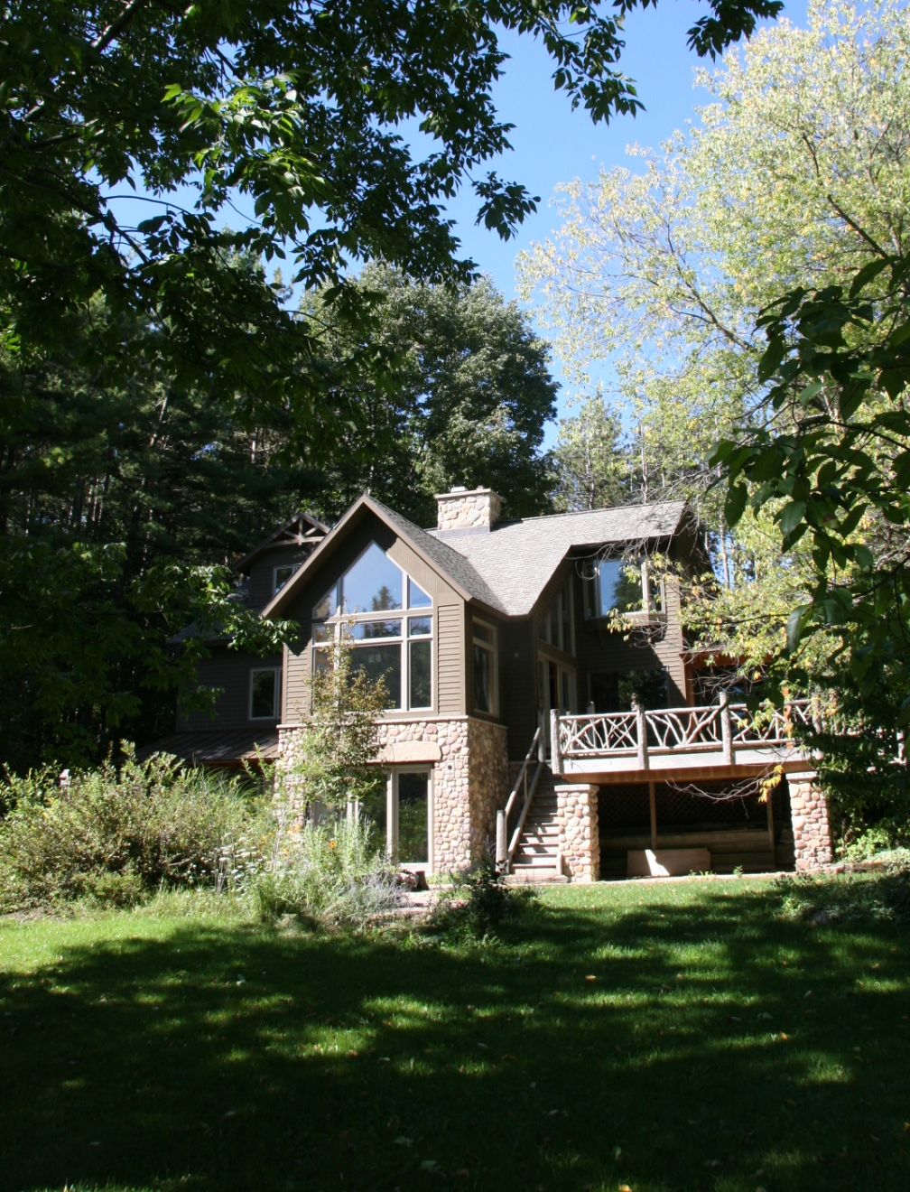
Step 4: Design Goals
Perform within the environmental boundaries of a given reference ecosystem
Natural and biological processes to achieve performance goals whenever possible
Passive Solar

Slide 28
Design within planetary boundaries to protect life for the next seven generations

