Slide 4
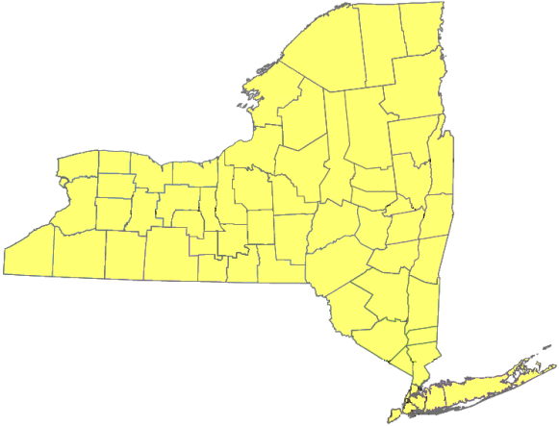
NYS Community Development Block Grant Program
_____________________________
Program Year 2011
Environmental Finance Center
Smart Management for Small Communities:
Practical Resources for Local Governance
Holiday Valley Inn & Conference Center
October 6-7, 2010

Slide 5

New York State
Community Development Block Grant Program
Develop viable communities by providing decent housing and a suitable living environment, as well as expanding economic opportunities, principally for persons of low- and moderate-income.
NYS must ensure that at least 70% of its CDBG grant funds are used for activities that benefit low- and moderate-income persons (at or below 80% of median) and meet one of the National Objectives:
    Benefit low- and moderate-income persons or families; or
    Aid in the prevention or elimination of slums or blight; or
    Meet an urgent community development need
1,266 eligible communities in New York State

Slide 6
NYS CDBG 2010 Competitive Awards
Amount Requested: $70,733,884
Amount Awarded: $29,501,329
Applications Received: 159
Applications Awarded: 65

Slide 7
NYS CDBG 2010 Public Infrastructure
Public Sewer Projects
  7 Projects funded at $4,129,824
    Total project costs $5,023,654
    Leveraged funds $893,830
Public Water Projects
  11 Projects funded at $6,351,300
    Total project costs $9,878,469
    Leveraged funds $3,527,169

Slide 8
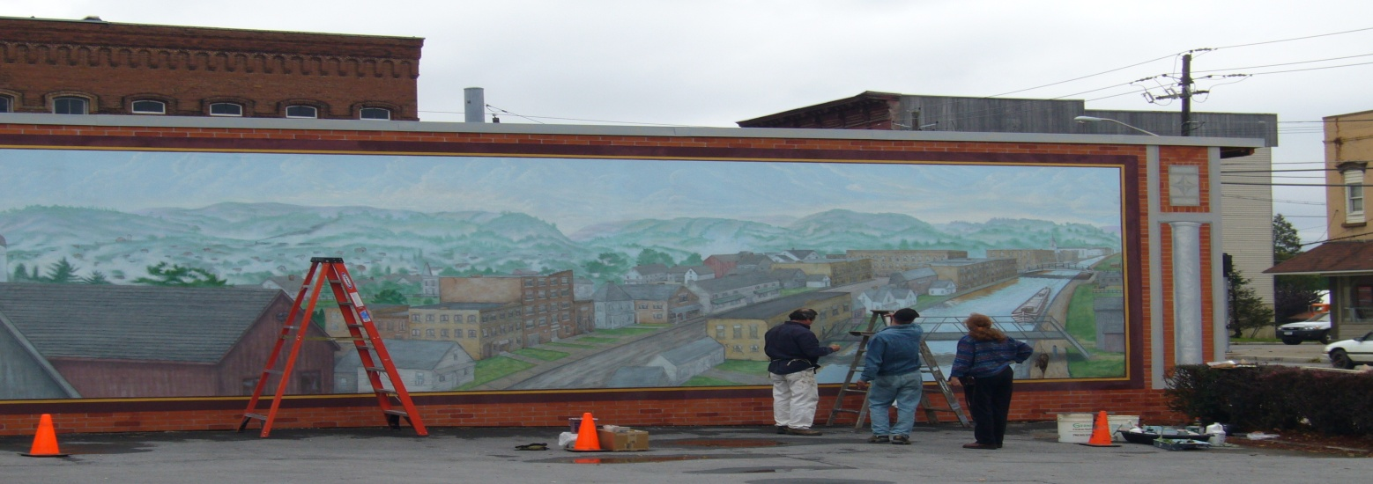
Eligible Applicants
CDBG Non-entitlement Communities: Towns, Cities and Villages with a population under 50,000 and Counties with an area population under 200,000

Slide 9
Eligible Activities
NYS CDBG Annual Competitive Program:
  Public Infrastructure (public sewer and water)
  Housing
  Public Facilities
Economic Development Open Round Program:
  Microenterprise
  Small Business
  Traditional Economic Development

Slide 10
National Objective Compliance
All NYS CDBG funded activities must demonstrate compliance with one of the following:
  LMA – used to demonstrate 51% LMI area wide benefit
  LMH – direct assistance to income eligible household
  LMC – assistance provided to a limited clientele
  LMJ – jobs made available and/or taken by LMI persons for economic development based projects
  LMJFI – jobs made available and/or taken by LMI persons for facilities improvements
  LMCMC- micro assistance provided to a LMI business owner

Slide 11
2010 Funding Limits
Public Infrastructure
  Sewer and Water Projects
    Towns, Cities or Villages: $600,000
    Counties: $750,000
Shared Municipal Infrastructure
  Joint project between two municipalities, mutual benefit to both municipalities
    Infrastructure: $900,000
Notes:
Funding limits were changed in 2009 to accommodate the needs that we had seen reflected in applications.
No changes to the limits in 2010
Counties can apply for up to $750,000 under all categories.
Towns, Cities or Villages can apply for up to $400,000 for housing and public facilities and $600,000 for infrastructure.
Shared Municipal Infrastructure up to $900,000 for water sewer only. Two municipalities must have joint need; must need to work together to resolve the need. Example – Village system that extends into the Town, but the Town has no control or obligation to the system, is NOT shared municipal. However, two towns that decide to combine resources and create a joint municipal wastewater treatment facility would be considered a shared project.

Slide 12
2010 Funding Limits
Housing
  Sewer and Water Lateral Connections, Wells and Septic Replacement
    Towns, Cities or Villages: $400,000
    Counties: $750,000
Economic Development
    $100,000 to $750,000 or no more than 40% of total project cost, whichever is less
    Must result in creation/retention of at least one FTE job for each $15,000 in CDBG assistance
Notes:
Funding limits were changed in 2009 to accommodate the needs that we had seen reflected in applications.
No changes to the limits in 2010
Counties can apply for up to $750,000 under all categories.
Towns, Cities or Villages can apply for up to $400,000 for housing and public facilities and $600,000 for infrastructure.
Shared Municipal Infrastructure up to $900,000 for water sewer only. Two municipalities must have joint need; must need to work together to resolve the need. Example – Village system that extends into the Town, but the Town has no control or obligation to the system, is NOT shared municipal. However, two towns that decide to combine resources and create a joint municipal wastewater treatment facility would be considered a shared project.

Slide 13
Annual Competitive Program
  Public Infrastructure Sewer and Water Projects
    Must provide clearly defined service area, including all serviced households, including habitable vacant and seasonal units
    Service area must be 51% low-and moderate-income
    Drinking water and wastewater treatment plant construction/upgrades
    Distribution, transmission and collection line installation and replacement
    Water storage tanks
    Lateral connection assistance, treated as a housing activity

Slide 14
Annual Competitive Program
Housing Rehabilitation, Wells and Septic Systems
  Single-family housing
    Household must be low- and moderate-income
  Multi-family housing
    At least 51% of the units must be low- and moderate-income
Economic Development
    Infrastructure improvements
    Demonstrate compliance with LMJFI

Slide 15
Annual Competitive Program
Public Facilities
  Activities may include storm drainage repairs and improvements, removal of architectural barriers, multi-purpose or community centers
  At least 51% of the service area population must be low- and moderate-income
  Any public facility funded with CDBG funds must be maintained in the same capacity for five (5) years following closeout of the project
  Cannot fund buildings used for the general conduct of government

Slide 16
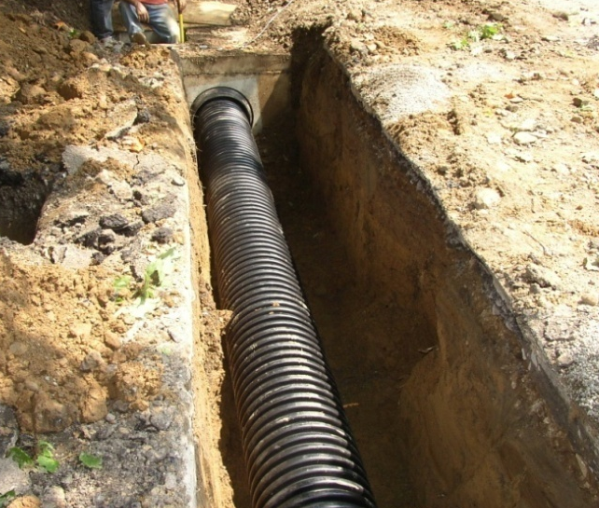
Need
Description of:
  Need for NYS CDBG funds
  Existing conditions and area benefiting
  How EDU’s were calculated
  Impact on user costs
  Operations and maintenance costs
  For lateral connections, include current conditions
Supporting Documentation:
  Engineer/Architect reports
  Consent orders, other violations, or regulatory letters
  Map of entire service area
Notes:
Existing conditions including any orders; health hazards; should be current and relevant to the project being proposed;
Area benefitting – should be the entire area that will receive a benefit from the project;
Discuss how your EDU’s were calculated
Discuss operations and maintenance costs – often the application will indicate that these improvements will provide energy and man power costs savings, but not reflected anywhere in the application

Slide 17
Project Description
Be specific to the project and activities being proposed
Should clearly demonstrate that the project will address the identified needs
Detailed to provide a complete picture of the project
Provide supporting documentation
Sustainability
Compliance with Smart Growth Legislation enacted on 8/31/2010
For lateral connections, include a brief description
Notes:
If part of a larger project, briefly describe the larger project and focus on the use of CDBG funds;
We need to understand what the CDBG funds will be used for;

Slide 18
Document National Objective Compliance
Public Water and Sewer and Public Facilities Projects
  LMI Area Benefit Test, at least 51% of the persons benefiting must have incomes at 80% or below the area median income
Water and Sewer Lateral Projects
  Direct Benefit Activity
  Single-family household must be at 80% or less of area median income LMI
  Multi-family units must have at least 51% of units qualify as LMI or be made available to LMI households
  Application must demonstrate a sufficient pool of eligible applicants

Slide 19
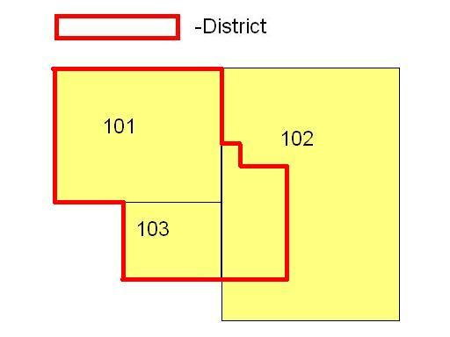
National Objective: Low Mod Area Benefit
Two methods to demonstrate compliance
Census Data
  Must match area benefitting
Survey Data
  Survey data results must be summarized
  Survey instrument should be adequate to demonstrate eligibility
  Must include total population of the service area not just respondents
Notes:
If you’re going to use Census tract or block group figures, the boundaries of your service area must be coterminus with the census tract boundaries otherwise a survey is required; cannot use census data if only a portion is benefiting;
Surveys – strict guidance is provided in the application; include a summary of the survey results and sample methodology and forms; be careful how income is requested, ensure that any ranges used, don’t overlap income ranges; include all of the users not just the respondents, include vacant and seasonal units in total count (dilapidated or uninhabitable don’t need to be included)

Slide 20
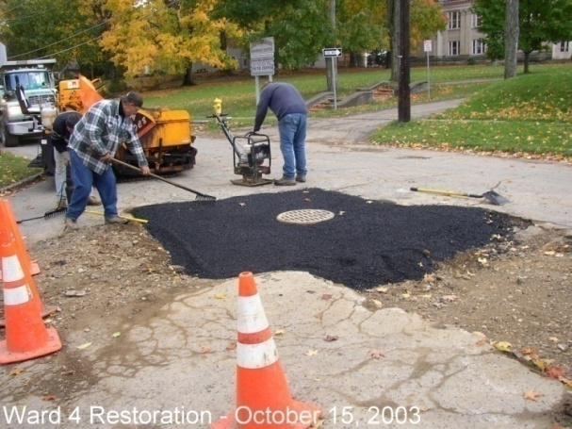
Budget
  Provide budget for entire project
Identify all funding sources, committed & projected, such as Rural Development, EFC and local funds
Leveraged funds should be available and committed at time of NYS CDBG award
Explain any budget gaps that may exist
Supporting Documentation
  Up to date Engineer/Architect estimates
  Ensure prevailing wages were used when preparing estimates
  If force account labor, evidence of commitment of all resources
  Cost benefit analysis
Notes:
If asking for full amount of funds from different sources, don’t double count in budget, make sure it reflects the total budget costs
Explain user costs, debt service, impact of cdbg; if other CDBG only covers a portion of the costs, explain where other funding is coming from;

Slide 21
PY 2011 Proposed Competitive Round Timeline
Notes:
For the competitive round only.
NOFA will provide deadlines and guidance for application submittal. In addition, the application packet will be available at the same time.

Slide 22
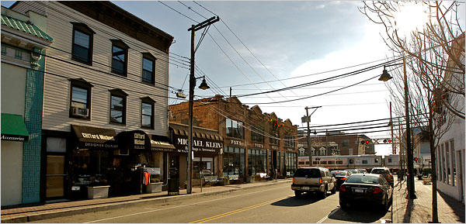
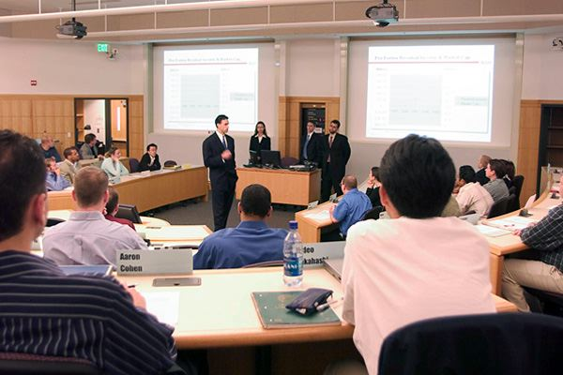
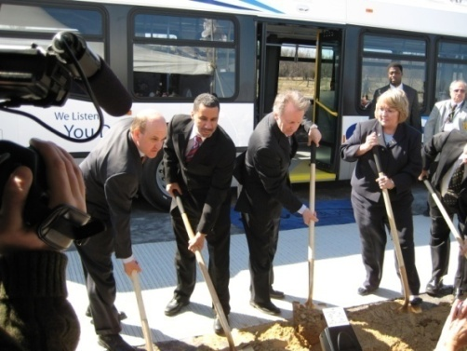
Economic Development Programs
  Open window, year-round applications
  Community applies on behalf of business
  Each project must principally benefit persons from LMI households
  Improvements to public infrastructure needed to assist with traditional Economic Development for the attraction-expansion-retention of business
  Funding of last resort

Slide 23
Economic Development Funding Limits
Economic Development
  $100,000 to $750,000 or no more than 40% of total project cost, whichever is less
  Must result in creation/retention of at least one FTE job for each $15,000 in CDBG assistance
Small Business
  $25,000 to $100,000, or up $25,000 per job
  Business must have 25 or fewer employees at time of application

Slide 24
Technical Assistance
One on One technical assistance (TA) is available at any time
  TA can be held in the field or our offices
  CEO or a municipal employee must participate in the technical assistance

Slide 25
Public Infrastructure Contact Information
Rob Brooks, Senior Community Developer
rbrooks@nyshcr.org
Charlie Philion, Community Developer
cphilion@nyshcr.org
For Economic Development Infrastructure Only:
Jessica Henderson, Economic Developer
jhenderson@nyshcr.org
Office of Community Renewal
Hampton Plaza
38-40 State Street, 9th Floor
Albany, NY 12207
(518) 474-2057
http://www.nyshcr.org

Slide 26
Contact Information for all other Programs
http://www.nyshcr.org
New York Main Street Program
  Karl Gustafson
  kgustafson@nyshcr.org
NYS Affordable Homeownership Development Program (AHC)
  Dominic Martello
  dmartello@nyshcr.org
Neighborhood Stabilization Program (NSP)
  Brian Segal
  bsegal@nyshcr.org
Urban Initiatives
  Pat Doyle
  pdoyle@nyshcr.org

Slide 27
Contact Information
www.nyshcr.org
Rural Area Revitalization Program (RARP)
  Pat Doyle
  pdoyle@nyshcr.org
Neighborhood and Rural Preservation Program (N/RPC)
  William Allen
  wallen@nyshcr.org
HOME Local Program Administrators
  Pat Doyle
  pdoyle@nyshcr.org
Access to Home
  Pat Doyle
  pdoyle@nyshcr.org

Slide 28
Contact Information
www.nyshcr.org
RESTORE
  Pat Doyle
  pdoyle@nyshcr.org
Subprime Foreclosure Prevention Services Program
  Greg Watson
  gwatson@nyshcr.org
Sustainable Neighborhoods Demonstration Program (SNDP)
Pat Doyle
  pdoyle@nyshcr.org

